Slide 1
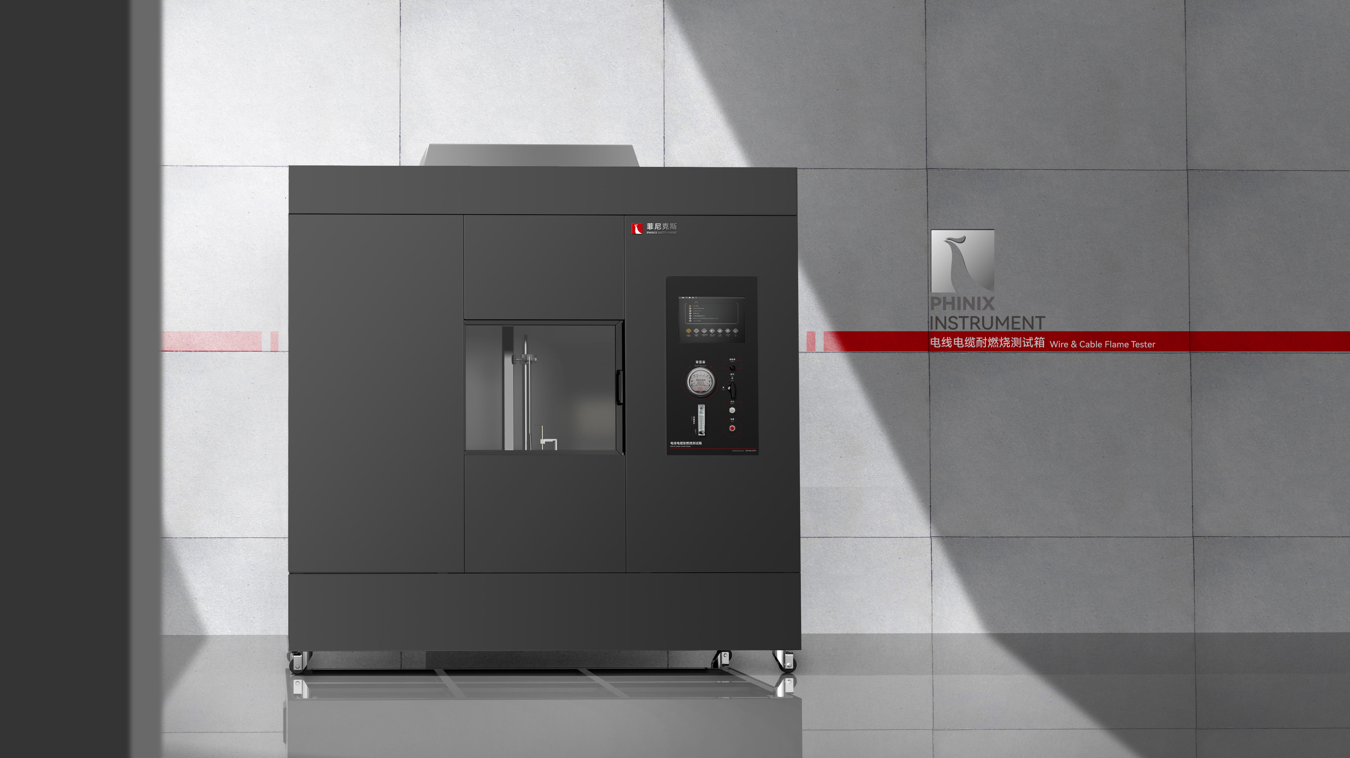
The Expert In Fire Testing
VW-1 Wire And Cable Fire Resistance Tester
VW-1 Wire And Cable Fire Resistance Tester according to the requirements of UL1581/UL2556, ASTM D 5025/ASTM D5207 standard test machine, used to test the fire resistance of the insulation layer of wire and cable.
Product Standard
Product Parameters
UL1581 Sect 1080.1~1080.14: Flame retardant section of the Reference Standard for Wires, Cables and cords
UL2556 Clause 9: Flame retardant part of test method for wire and cable
ASTM D 5025: Specification for Laboratory furnaces for Small scale Combustion tests of Plastics
GB/T 5169.15: Test flame 500W flame apparatus and confirmation test method
Model PX02009
Dimension 2010(W)×1200(D)×2150(H)mm
Power Supply AC220V,5A
Weight APPR. 150kg
Gas Source Methane with purity above 98%
Features
Combustion Chamber size 4 cubic meters, frame structure thickened plate steel production.
The front side of the chamber is equipped with a translation observation window, which is convenient for observing the test process and carrying out sample change. The side door is convenient for operators to enter the chamber for equipment cleaning and maintenance
Smoke exhaust device is installed on the top, which can automatically open to discharge test exhaust gas after the end of the test. The side wall is equipped with inlet baffle, which is automatically opened to replenish clean air when discharging smoke without manual operation.
Equipped with stainless steel vertical sample fixture, durable, can withstand high temperature and flame impact. The installation method is convenient and can clamp the sample of different line specifications.
Equipped with imported precise rotor flowmeter to control gas flow, equipped with imported differential pressure measurement burner back pressure.
Equipped with brand pressure gauge and pressure regulating valve to adjust gas pressure, equipped with solenoid valve to control gas on and off, to ensure the safety of equipment.
Jiangsu Firemana Safety Technology Co., LTD
www.firemana.com
Add: D3 Safe Valley Of China, Tongshan District, Xuzhou City, Jiangsu Province,China
0516-83843888
400-086-0699

Slide 2
The Expert In Fire Testing
Continued Page
Equipped with HUMBOLDT Tyrell fire source, inner diameter 9.5±0.3mm, in accordance with ASTM D5025 standard
The burner is installed on the sliding seat, which can realize the automatic adjustment of various angles through the motor, and the automatic completion of multiple flame shocks.
High pressure pulse automatic ignition, ignition stability and reliability, high security
Programmable logic controller (PLC)+ touch screen control, can realize automatic control/detection/calculation/data storage
Test time, fire time can be set by oneself, software automatic timing
Linear combustion rate (V) calculated by PLC, data displayed and saved by touch screen
Optional 500W flame calibration kit, imported brand thermocouple measurement accuracy ±0.1℃, can automatically generate calibration curve and determine.
Jiangsu Firemana Safety Technology Co., LTD
www.firemana.com
Add: D3 Safe Valley Of China, Tongshan District, Xuzhou City, Jiangsu Province,China
0516-83843888
400-086-0699

