Slide 1
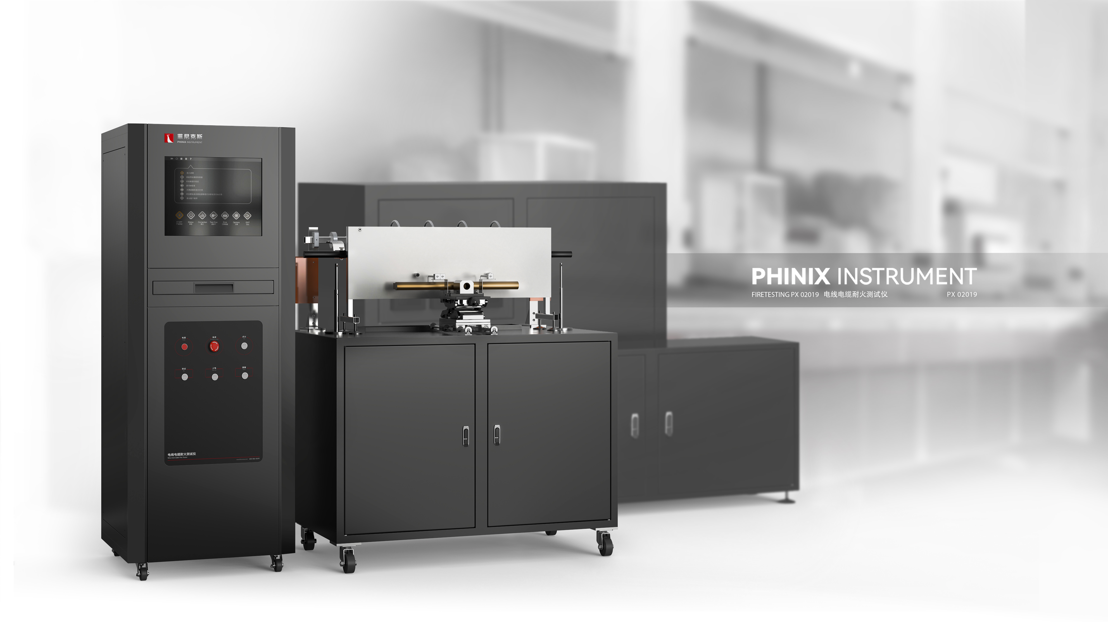
The Expert In Fire Testing
Wire And Cable Fire Resistance Tester
The test apparatus is used to test the circuit integrity of cables exposed to flame when the flame temperature reaches at least 750℃.
Product Standard
Product Parameter
IEC 60331 Part 11: Tests on cables under fire conditions -- Equipment circuit integrity under fire at a temperature of at least 750℃
IEC 60331 Part 21: Test circuit integrity of cables under fire conditions
GB/T 19216: Cable or optical cable line integrity test under flame condition
Model PX02019
Equipment：1,600(W)×850(D)×1,650(H)mm
Console：600(W)×750(D)×1,200(H)mm
Power Supply AC 380V 3-phase, 50/60Hz, 30A
Weight APPR.100kg
Exhaust Minimum 15㎥/min
Tools Vacuum cleaners, computers, compressed gas, propane gas
Dimension
Feature
Steel structure chamber, frame structure, stable, beautiful and generous
Combustion device and control chamber, gas distribution cabinet, distribution cabinet separate design, easy to laboratory manipulation, and determine the safety of equipment
The heat source is a belt propane burner burner with a nominal nozzle length of 500mm
3 rows of combustion holes are staggered, the average front width of the burner is 15mm, the diameter of the hole is 1.32mm, and the distance between the center of the hole is 3.2mm. A row of guide holes are arranged on both sides of the nozzle plate to keep the flame burning
Equipped with venturi to fully mix air and gas to meet combustion requirements
Equipped with brand pressure gauge and pressure regulating valve to adjust gas pressure, equipped with solenoid valve to control gas on and off, to ensure the safety of equipment.
High voltage pulse automatic ignition, ignition stability, safety and reliability
The cable sample is supported by two metal rings, the middle length is about 300mm, and other connecting parts are outside the two metal rings. The inner diameter of the metal ring supported by the sample is 150mm, and the ring cross section diameter is 10±2mm
Jiangsu Firemana Safety Technology Co., LTD
www.firemana.com
Add: D3 Safe Valley Of China, Tongshan District, Xuzhou City, Jiangsu Province,China
0516-83843888
400-086-0699

Slide 2
The Expert In Fire Testing
Continued Page
The position of burner burner is not less than 200mm away from the bottom of the combustion box, and the height of the burner can be adjusted up and down to meet the sample test requirements of different wire diameters, and the distance from the box wall is not less than 300mm
The lower end of the burner burner horizontal wheelbase cable sample is 70±10mm, and the vertical axis of the burner burner vertical wheelbase cable is about 45mm
MFC or high-precision rotor flowmeter can be equipped according to customer's requirements to provide gas and combustion air to the blowtorch
Five thermocouples with copper welded ends are used to measure backfire temperature
Programmable controller (PLC) automatic timing, automatic fire extinguishing or early warning of time arrival function
Computer + professional software control, guided operation, easy to operate safe and reliable
Automatic display of temperature rise data and curve, can query historical data and curve, provide temperature alarm function
Jiangsu Firemana Safety Technology Co., LTD
www.firemana.com
Add: D3 Safe Valley Of China, Tongshan District, Xuzhou City, Jiangsu Province,China
0516-83843888
400-086-0699

