Slide 1
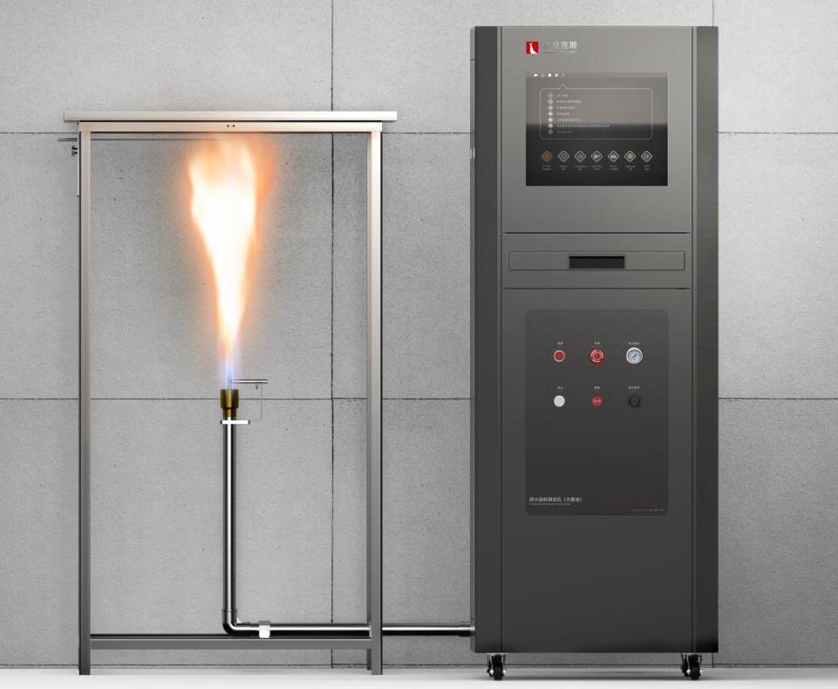
The Expert In Fire Testing
Decorated Anti Fire Coating Combustion Tester (Large Plate Method)
According to the technical conditions of national standard GB12441-2005, fire coating tester is suitable for testing the fire resistance characteristics of fire coating on the surface of combustible base material. Controlled by computer, the test report is easy to print.
Product Standard
GB 12441-2005 General technical specifications for decorative fire retardant coatings Appendix A
Product Parameter
Model PX07021
Combustion Cabinet：820(L)×820(D)×1500(H)mm
Console：650(L)×675(D)×1750(H)mm
Power Supply AC 220V , 50/60Hz, 10A
Weight APPR. 120kg
Gas Source Propane/LPG
Dimension
Feature
The test frame is made of 30×30×3mm stainless steel Angle welded, its internal size is 760×760×1400mm, the lower foot of the frame is 100mm high, and the upper end is used to place the burner
Asbestos pressing plate is made of 900×900×20mm asbestos plate, with a diameter ￠500mm circular hole in the center
The separate design of the combustion device and the control box is convenient for the laboratory to manipulate and ensure the safety of the equipment
The centrifugal fan is controlled by a frequency converter to provide air for combustion
Equipped with venturi fully mixed air and gas mixing ratio to meet burner flame combustion requirements
Equipped with K-type armored thermocouple to measure ambient temperature and flame temperature, flame thermocouple design for adjustable position type clamping, meet the test requirements of common samples and foamed samples
The sample device is 5mm thick rubber board, and the fire-resistant surface is coated with fire-resistant coating for testing
Jiangsu Firemana Safety Technology Co., LTD
www.firemana.com
Add: D3 Safe Valley Of China, Tongshan District, Xuzhou City, Jiangsu Province,China
0516-83843888
400-086-0699

Slide 2
The Expert In Fire Testing
Continued Page
The burner pipeline is made of stainless steel pipe. One end of the three-way valve is installed in the middle of the pipe and is connected with the air source provided by the fan. The other end is connected with the gas through the pagoda joint at the end of the nozzle
The burner is equipped with silicon nitride ignition rod and UV flame detector, ignition is stable and reliable, and has real-time flame monitoring effect, prevent gas leakage, improve test safety
MFC controls gas flow and is equipped with regulating pressure gauges and regulating valves to control intake conditions and provide a stable combustion flame
Five thermocouples with copper welded ends are used to measure backfire temperature
Programmable controller (PLC) automatic timing, automatic fire extinguishing or early warning of time arrival function
Computer + professional software control, guided operation, easy to operate safe and reliable
Automatic display of temperature rise data and curve, can query historical data and curve, provide temperature alarm function
Jiangsu Firemana Safety Technology Co., LTD
www.firemana.com
Add: D3 Safe Valley Of China, Tongshan District, Xuzhou City, Jiangsu Province,China
0516-83843888
400-086-0699

