Slide 1
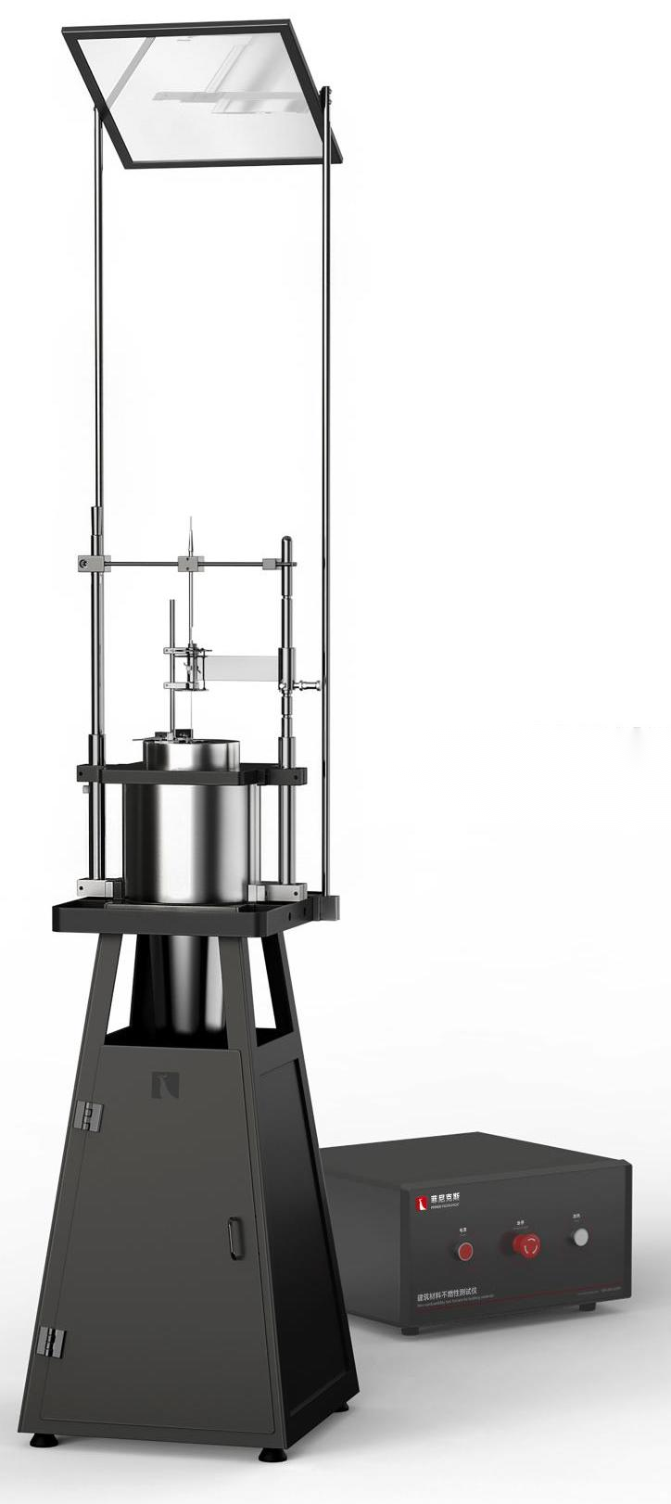
The Expert In Fire Testing
Non-combustibility Test Furnace For Building Materials
Non-combustibility Test Furnace For Building Materials is used to test the incombustibility of uniform building products and non-uniform building products under 750℃ furnace temperature, suitable for testing the combustion performance of building materials GB8624 grade A fireproof material classification. The equipment can fully meet both GB/T 5464 and ISO 1182 standards.
Product Standard
GB/T 5464: Method of test for non-combustibility of building materials
ISO 1182: Fire reaction tests for building products - Non-combustibility tests
BS 476-4-11 Fire tests on building materials and structures-Determination of the incombustibility of materials (optional square hanging basket)
Product Parameters
Model PX07002
Heating furnace：400(W)×400(D)×1400(H)mm
Control Cabinet：480(W)×430(D)×240(H)mm
Power Supply AC 220V, 50/60Hz, 10A
Weight APPR. 50kg
Dimension
Features
Heating furnace for mold forming integral furnace, size φ 75× φ 90×150 (mm); The heating element is imported nickel-chromium resistance belt with thickness of 0.2mm and width of 3mm, with longer service life
The shell of the furnace is made of 304 stainless steel seamless steel tube, and the heat insulation device is filled between the shell and the furnace body to avoid the shell temperature being too high.
PID temperature regulation mode, the temperature in the furnace can rise to 900°C, when the experimental temperature is 750±5℃, the temperature drift within 10min can be controlled to ≤2℃
The sample cage is made of high temperature resistant stainless steel and can be equipped with heat resistant steel wire for loose material testing
The insertion mechanism is composed of stainless steel tubes with an inner diameter of 4mm, which can be smoothly inserted into the test position of the furnace core and positioned. The sample cage mounting mechanism can be smoothly loaded and unloaded and can fix the cage body not falling
Equipped with two type K thermocouple for testing the sample center electric temperature and surface temperature
The top observation mirror is optional to facilitate the user to observe the combustion state of the sample in the furnace.
Jiangsu Firemana Safety Technology Co., LTD
www.firemana.com
Add: D3 Safe Valley Of China, Tongshan District, Xuzhou City, Jiangsu Province,China
0516-83843888
400-086-0699

Slide 2
The Expert In Fire Testing
Continued Page
Imported K thermocouple timely detection of furnace temperature, accuracy ±0.1°C
Air cover is installed on top of furnace body, inner diameter 75mm, height 50mm
A conical flow stabilizer made of stainless steel is installed at the bottom of the furnace body to provide stable airflow for the test, and an open-door airflow screen can facilitate the maintenance of the equipment
PC+Labview professional software real-time display furnace temperature, can realize automatic control, data acquisition and processing, data storage and output measurement results
The program can automatically generate experimental report and output.
Optional furnace/furnace wall temperature calibration device for furnace temperature correction
Jiangsu Firemana Safety Technology Co., LTD
www.firemana.com
Add: D3 Safe Valley Of China, Tongshan District, Xuzhou City, Jiangsu Province,China
0516-83843888
400-086-0699

