Slide 1
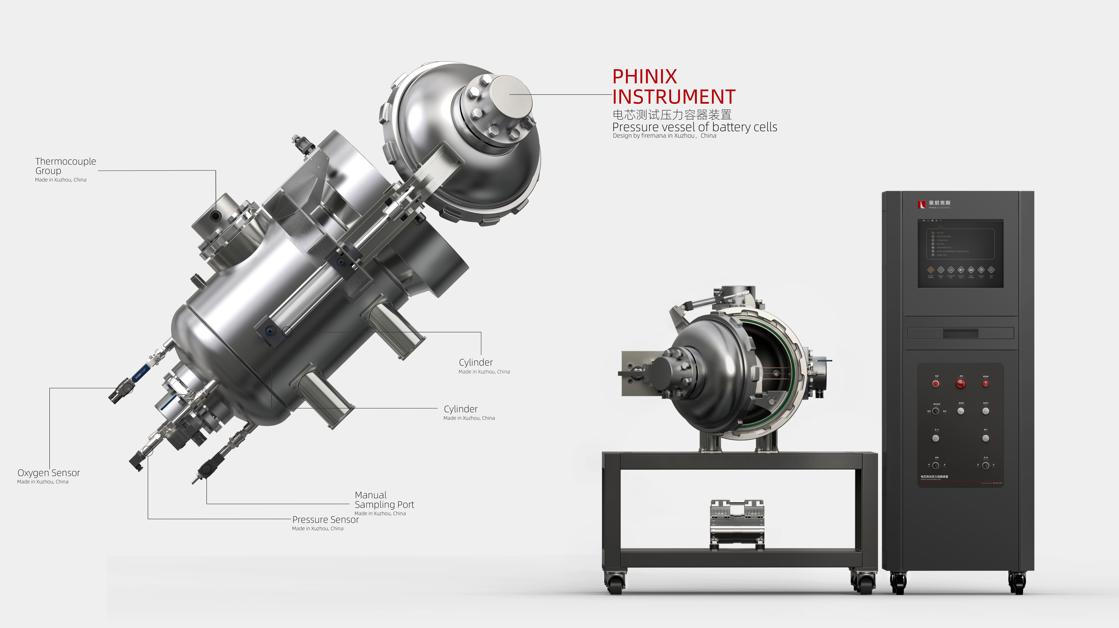
The Expert In Fire Testing
Cell Test Pressure Vessel Device
The cell test pressure vessel device is mainly used to meet the requirements of UL 9540A for cell thermal runaway test. It can meet the requirements of commercially available battery placement, internal cavity vacuumization, nitrogen filling function, pressure, temperature, oxygen concentration and other parameters measurement. In addition, it reserves a film heating interface and overshot circuit interface.
Product Standard
Product Parameter
UL 9540A: 2019 -7.4.1Part.
Model PX05001
Platform size：1000(W)×1000(D)×1400(H)mm
Console：650(W)×675(D)×1750(H)mm
Power Supply AC 220V, 50/60Hz,10A
Weight APPR.600kg
Gas Source Nitrogen with purity above 99.99%
Dimension
Feature
The sealed chamber is made of 304 stainless steel, with an internal diameter of 480mm and a length of 500mm. The test space volume is about 90L.
The maximum pressure of the cabin is 10Mpa, the constant pressure is not less than 3MPa, the cabin is equipped with engineering pressure 6.4mpa safety valve.
The cabin reserved a number of flanged connecting plate, the connecting plate is used for temperature, voltage, heating, overstroke and other lines connection. And reserved - channel nitrogen filling interface for connecting external nitrogen to achieve the oxygen concentration of the cabin. 1% environment configuration.
The device reserves 13 temperature collection channels, and the temperature display precision is 0.1°C
The device reserves two voltage acquisition signals to test the real-time voltage variation of the battery cell.
Manual ball valves and solenoid valves are reserved for all pipelines and sensor interfaces to protect sensors and block gas leakage in the cabin
A manual sampling interface is reserved and equipped with a mode filter with a filter precision of 0.μm.
The independent design standard electrical control cabinet, built-in 19 inch touch screen, metal frame structure, surface using electrostatic spraying, high-temperature baking and other processes, dirty, wear-resistant, oil resistant, easy to clean, beautiful and generous.
Jiangsu Firemana Safety Technology Co., LTD
www.firemana.com
Add: D3 Safe Valley Of China, Tongshan District, Xuzhou City, Jiangsu Province,China
0516-83843888
400-086-0699

Slide 2
The Expert In Fire Testing
Continued Page
The battery mounting port is opened and closed by movable door, and is equipped with locking screws to ensure the tightness of the cabin body. The movable metal sample bracket is equipped internally, and the structure is imported and placed smoothly.
Equipped with Thomas sampling pump, the exhaust speed can be manually adjusted to achieve -90kpa vacuuming capacity inside the cabin.
Equipped with pressure sensor, pressure monitoring range -0.1mpa -- 0.5mpa (can be customized according to actual use)
Using Siemens programmable control system (PLC) and analog module, equipped with Labview host computer software, it can realize real-time monitoring, display and data storage of temperature, cavity pressure, oxygen concentration and other data as well as test process, and can make reports and report output of test process data. It is stored in Excel, Word, PDF and other file formats for easy viewing and editing.
Jiangsu Firemana Safety Technology Co., LTD
www.firemana.com
Add: D3 Safe Valley Of China, Tongshan District, Xuzhou City, Jiangsu Province,China
0516-83843888
400-086-0699

