Slide 1
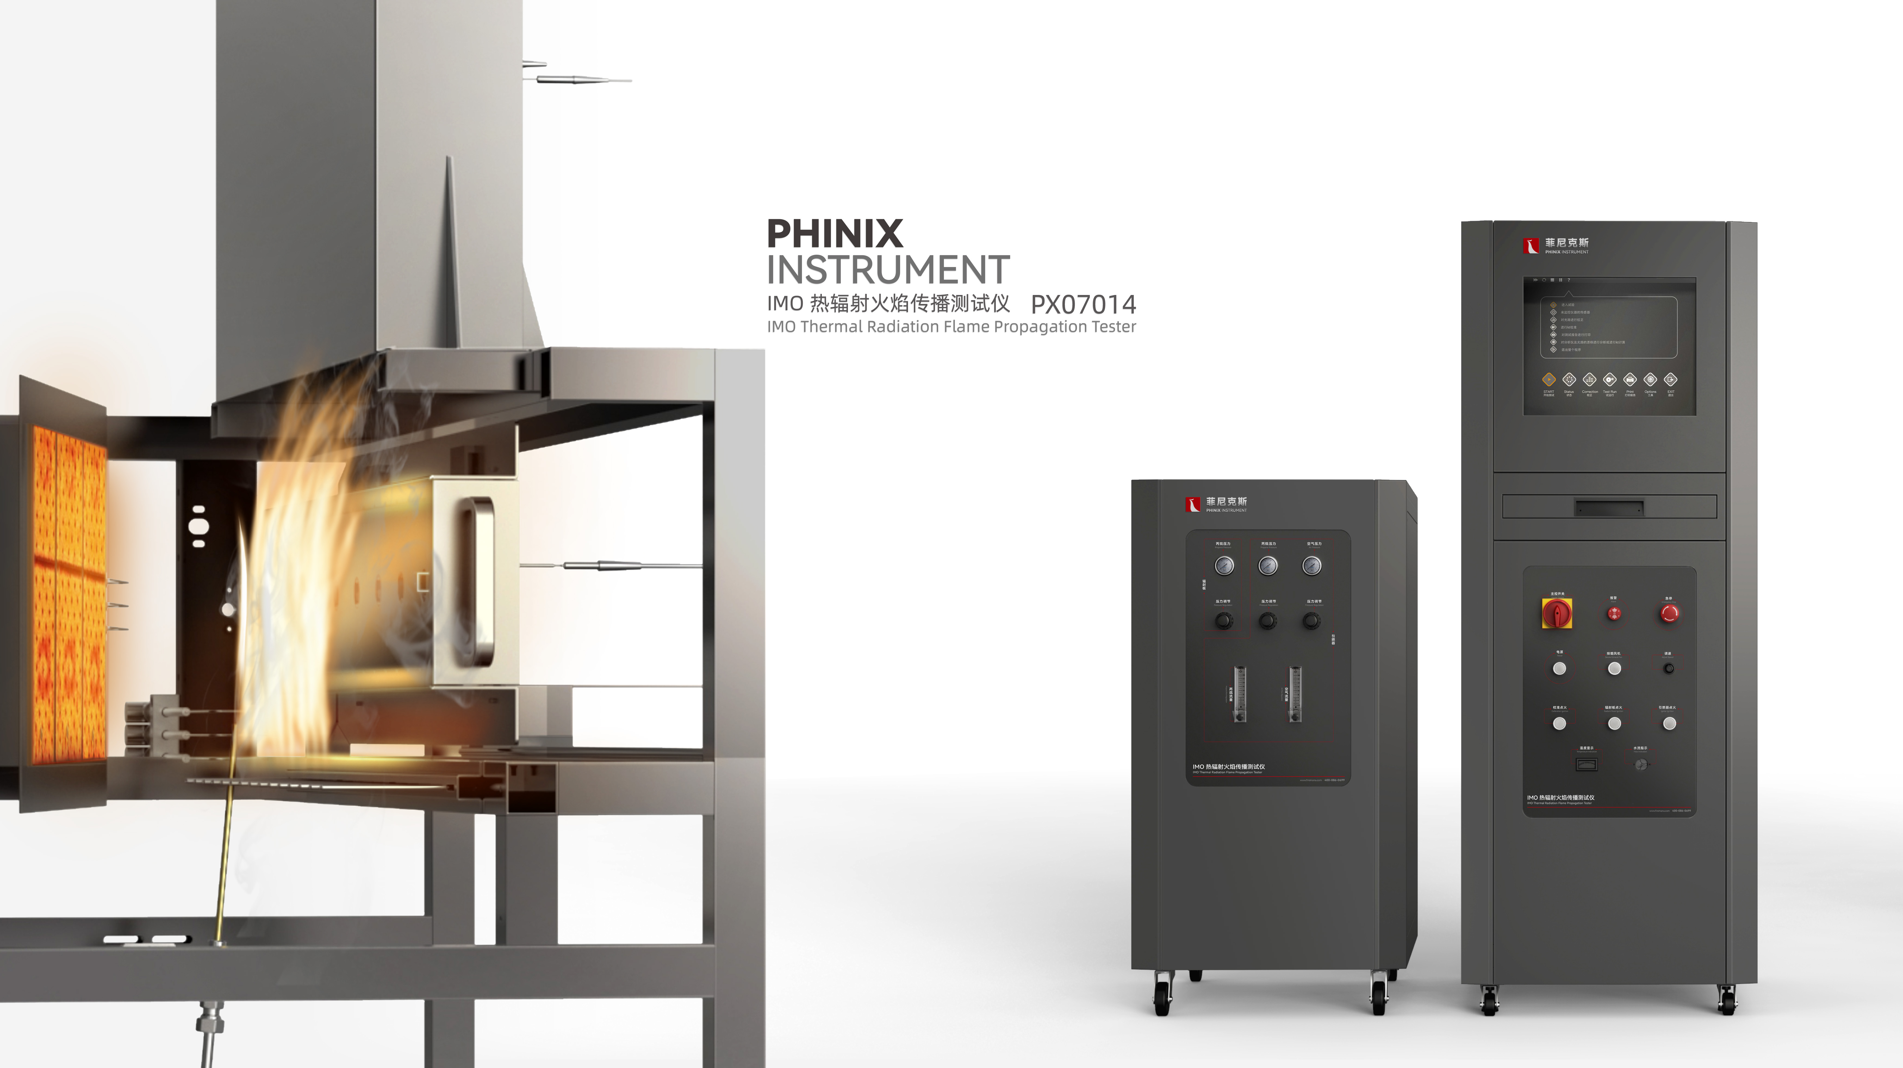
The Expert In Fire Testing
IMO Thermal Radiation Flame Propagation Tester
IMO Thermal Radiation Flame Propagation Tester is developed according to IM0 FTPC Part 5 and 6 IMO Res 653(16)_EN and GB/T 28752-2012 flame spread test method on vertical surface. It can be used to measure the presence of ignition flame in the laboratory. The properties of a material, product, or component corresponding to radiant heat.
Product Standard
Product Parameter
GB/T 28752-2012: Test method for transverse spread of flame on vertical surfaces
IM0 FTPC Part 5 and 6 IMO Res 653(16)_EN
Model PX07014
Equipment：1500(W)× 800(D)×2650(H)mm
Console 1：650(W)×675(D)×1750(H)mm
Console 2：650(W)×675(D)×1200(H)mm
Power Supply AC 220V,25A
Weight APPR. 220kg
Gas Source Propane with purity above 95%
Dimension
Feature
Stainless steel chamber, frame structure design makes the chamber stronger
Independent control cabinet, convenient for testing chamber layout, and away from fire to avoid the influence of high temperature on the electrical components of control room
Infrared radiation plate, stainless steel frame, built-in spoiler device, so that the flame uniform and stable.
The radiation plate adopts mechanical rotating device, which can be quickly positioned in the test position
A ceramic igniter is provided to apply an open flame to the sample
Imported precise rotor flowmeter to adjust and control the air intake of the igniter
Igniter is automatically ignited by high voltage pulse, ignition is stable, safe and reliable
Equipped with standard porous calibration plate device, with heat flow meter to calibrate the radiation plate. Heat flux meter calibration adopts mobile mode, users can move the heat flux meter and easily calibrate the radiation plate heat flux, while the testing software can draw the heat flux curve
Jiangsu Firemana Safety Technology Co., LTD
www.firemana.com
Add: D3 Safe Valley Of China, Tongshan District, Xuzhou City, Jiangsu Province,China
0516-83843888
400-086-0699

Slide 2
The Expert In Fire Testing
Continued Page
Propane MFC automatically controls the gas flow of the radiant plate, manually adjusts the fan speed to control the air flow, and the rotameter adjusts the gas flow of the igniter
The radiation plate is automatically ignited by high voltage pulse, which is stable, safe and reliable. And equipped with flame detection device, abnormal fire alarm and automatically cut off the gas source, to ensure the safety of the test
Heat flow meter with portable water cooling system, no external cooling water
Computer + professional software control, guided operation, easy to operate safe and reliable
Data can be automatically collected, calculated, saved, and output reports, real-time data and smoke density curve display/historical curve and data display and query
Jiangsu Firemana Safety Technology Co., LTD
www.firemana.com
Add: D3 Safe Valley Of China, Tongshan District, Xuzhou City, Jiangsu Province,China
0516-83843888
400-086-0699

