Slide 1
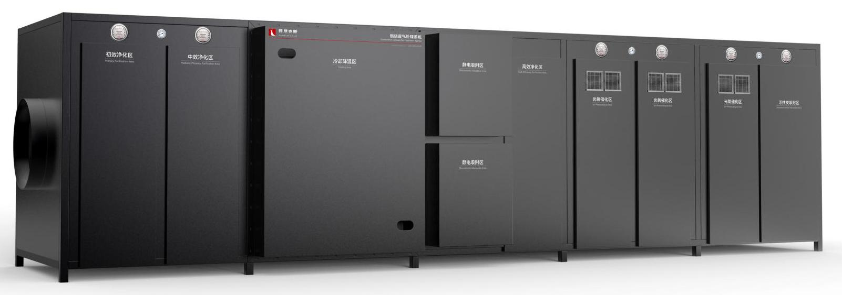
The Expert In Fire Testing
Combustion Exhaust Gas Treatment System
The combustion exhaust gas treatment system is aimed at the exhaust gas generated by the combustion of the sample during the experiment, heat exchange, filtration, activated carbon adsorption, UV light oxygen and so on to cool the box, remove solid particles, remove odor, purify the target gas for emission.
Product Standard
Product Parameters
GB 16297－1996：Comprehensive emission standards for air pollutants
Model PX01003
Dimension 6400(W)×1700(L)×1800(H)mm
Power Supply AC380V 25KW
Weight APPR. 2.5 T
Features
Steel structure chamber, sealed structure, simple and beautiful
Side door structure, convenient replacement of consumables
Primary filtration unit: fiber felt (folded structure), filtering large block particles. The outer frame is aluminum alloy/galvanized material; Filter grade: G2, G3; High temperature resistance, corrosion resistance, low resistance;
Medium effect filter unit: it is composed of folding bag type fine filter to filter fine particles. The outer frame is made of aluminum alloy; Filter grade: G3; Single metal mesh fixed, solid structure; Low initial resistance, large capacity;
The heat exchanger is placed in the exhaust duct, and the water is passed to the heat exchanger through the water pipe. Through the heat exchange of the heat exchanger, the heat of the high temperature gas in the air duct is fully absorbed, so as to achieve the purpose of cooling the hot air.
Using the cathode in the high voltage electric field emitted electrons, as well as by the electron collision of air molecules produced by the negative ion to capture soot particles, the soot particles charged, using the effect of the electric field, the charged soot particles adsorbed by the anode, in order to achieve the purpose of soot removal
Jiangsu Firemana Safety Technology Co., LTD
www.firemana.com
Add: D3 Safe Valley Of China, Tongshan District, Xuzhou City, Jiangsu Province,China
0516-83843888
400-086-0699

Slide 2
The Expert In Fire Testing
Continued Page
High efficiency filter unit: composed of ultrafine glass fiber filter paper, filter 0.1μm-0.3μm particles. The outer frame is made of galvanized or ABS plastic; Filter material: glass fiber, with high dust capacity, low resistance characteristics; Filtration efficiency: H10, H13, H14
Heat exchange cooling system consists of exhaust duct, fan, heat exchanger, circulating water pump, pipeline and other main parts
UV photooxygen system can effectively remove volatile organic compounds (VOC), inorganic matter, hydrogen sulfide, ammonia, mercaptan and other major pollutants, as well as a variety of odors
Using activated carbon as physical adsorbent, the harmful substances produced in the process of organic combustion are concentrated on the solid surface, so as to purify the waste gas
Equipped with smoke extraction fan, through the inverter control fan smoke volume
Jiangsu Firemana Safety Technology Co., LTD
www.firemana.com
Add: D3 Safe Valley Of China, Tongshan District, Xuzhou City, Jiangsu Province,China
0516-83843888
400-086-0699

