Slide 1
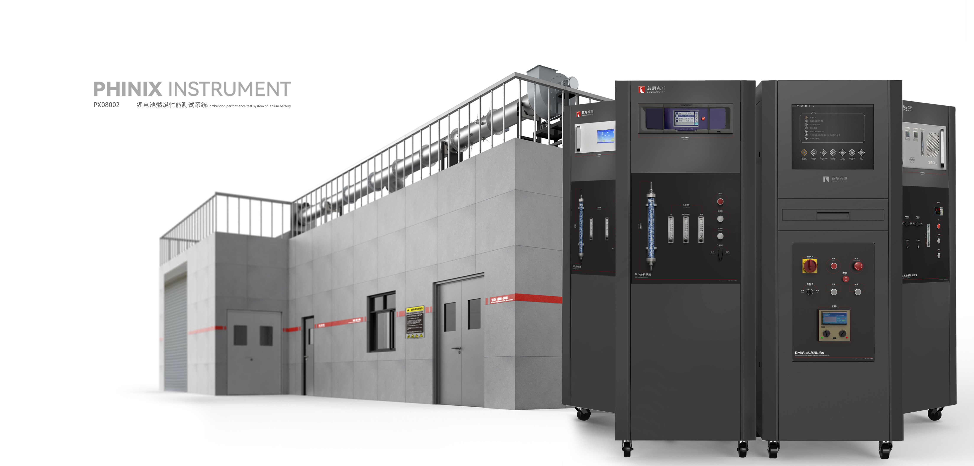
The Expert In Fire Testing
Lithium Battery Performance Test System
The lithium battery combustion performance test system refers to UL 9540A and calculates the heat release rate according to the principle of oxygen consumption.
It is used to test the combustion behavior and performance of lithium battery under thermal runaway condition, and measure the key data such as heat release rate, total heat release and smoke density. The combustion performance data of lithium battery under thermal runaway condition can be obtained through the test, and the fire and explosion hazard characteristics of battery energy storage system can be reflected through the test of heat release rate.
The system can be used in linkage with pressure vessel test device, Fourier sampling and analysis system, total carbon hydrocarbon sampling and analysis system and hydrogen sensor to meet the requirements of Cell, MOd-ULE, Unit and Installation in UL 9540A.
Product Parameter
Model PX08002
Floor Area：1300(L)×6500(W)×7000(H)mm
Console：650(L)×675(W)×1750(H)mm
Gas analysis Cabinet: 650(W)×675(D)×1750(H)mm
Power Supply AC380V 15KW 50Hz AC220V 5KW 50Hz
Weight APPR.20kg
Gas Source Ammonia, standard gas, methanol
Dimension
Product Standard
ANSI/CAN/UL 9540A: 2019
Feature
The smoke collecting hood and smoke pipe are made of 304 stainless steel, the diameter of smoke pipe is 400mm, and the flow equalizer device is used before and after the smoke exhaust pipe to ensure the uniform flow of gas
The exhaust capacity of the fan is 4kg/s, equipped with an independent frequency control cabinet, the fan frequency can be adjusted continuously to reduce signal interference, and the fan damping system is included
The test section adopts live interface, which can be used to connect temperature thermocouple, sampling tube, differential pressure probe, optical path system, flow velocity calibration device, infrared temperature sensor, etc., which is easy to disassemble and maintain, and easy to operate
Equipped with OMEGA thermocouple for measuring smoke tube and ambient temperature
Optional heat flux test system, temperature acquisition system, to meet the requirements of different levels of testing
Adopt independent standard gas sampling system, built-in multistage filtration, pressure regulation and flow regulation device, adopt imported condenser and desiccants to pretreat the gas, to ensure that the gas into the analyzer is dry, clean and stable, the pipeline adopts all stainless steel structure, the overall structure is beautiful, generous, long service cycle. Used in conjunction with the sampling tube of the test section
Paramagnetic type 0₂ analyzer and infrared CO₂ analyzer, oxygen range 0-25%, CO₂:0-10%, CO: 0-1%; Oxygen accuracy &lt; 0.02%, repeatability &lt; 0.01%, CO₂ accuracy 0.1ppm, CO accuracy 0.1ppm, repeatability 0.1ppm. Response time &lt; 8s
Jiangsu Firemana Safety Technology Co., LTD
www.firemana.com
Add: D3 Safe Valley Of China, Tongshan District, Xuzhou City, Jiangsu Province,China
0516-83843888
400-086-0699

Slide 2
The Expert In Fire Testing
Continued Page
The optical path system includes the transmitting end and the receiving end. The light source adopts imported bulbs and is equipped with a voltage regulator for power supply. The receiving end adopts imported optical path receiver, the signal is stable and reliable, and has multi-stage automatic optical path calibration and verification function
Differential pressure is measured using standard compliant bidirectional probe and Setra differential pressure sensor
Equipped with special oil pan to verify the stability and accuracy of heat release test system
An independent Kc verification device is optional for measuring the distribution of wind speed in the smoke tube
Electrical control adopts self-designed electrical cabinet, built-in integrated touch computer, with Siemens control module to achieve function control and data collection.
The upper computer software is designed based on NI Labview platform, equipped with a variety of calibration modes, real-time calculation and waveform display of volume flow rate, heat release rate, smoke generation and other parameters, can achieve data recording, calibration report and test report output view and other functions.
Jiangsu Firemana Safety Technology Co., LTD
www.firemana.com
Add: D3 Safe Valley Of China, Tongshan District, Xuzhou City, Jiangsu Province,China
0516-83843888
400-086-0699

