Slide 1
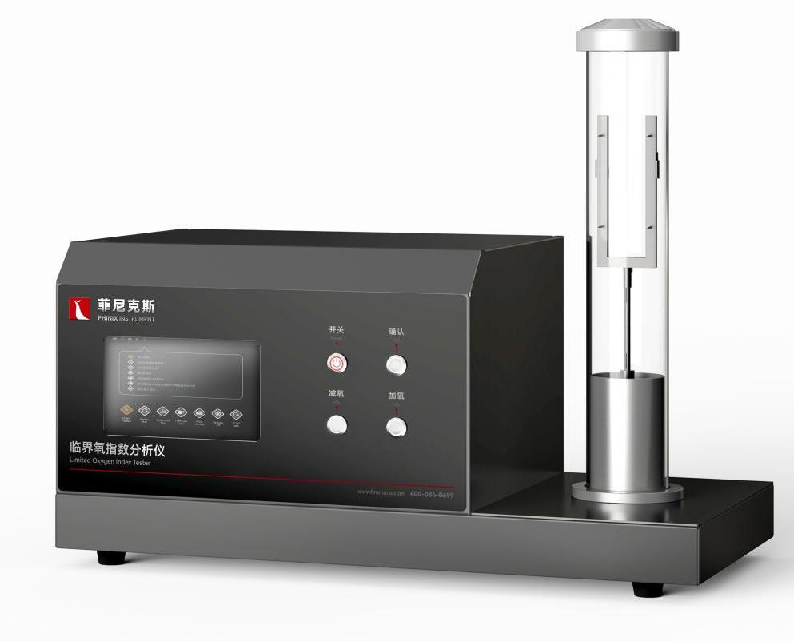
The Expert In Fire Testing
Limited Oxygen Index Tester
Limited Oxygen Index Tester can measure the minimum concentration of oxygen required for combustion of a sample. Oxygen index is an important reference value to measure the flame retardant properties of materials. Oxygen index refers to a certain size of the material (test piece) into the test device, under specified conditions, through the mixed gas of oxygen and nitrogen, the test piece is ignited with an igniter, determine the minimum oxygen concentration necessary to maintain continuous combustion (expressed in percentage). The instrument is imported paramagnetic oxygen concentration sensor, accurate measurement, long life, low error rate, high reliability.
Product Standard
ISO 4589-2Determination of oxygen index for combustion behaviour of plastics - Part 2 Ambient temperature test
ASTM D 2863
GB/T 5454-1997Flammability tests for textiles - Oxygen index method
GB/T 2406-2009Determination of combustion behavior of plastics by oxygen index method
GB/T 8924-2005Test method for flammability of fiber-reinforced plastics - Oxygen index method
GB/T 10707-2008Rubber - Determination of combustion propertiesQB/T 1650-1992 Rigid polyazoethylene foam sheet (as specified in 5.3.9 of the standard, refer to GB/T 2406)
Product Parameters
Model PX01005
Dimension 650(W)×375(D)×530(H)mm
Power Supply AC 220V, 50/60Hz,2A
Weight APPR.30kg
Gas Source Oxygen and nitrogen with purity above 99.99%; Propane with purity above 95%
Features
Integrated structure, industrial design appearance, beautiful and generous, easy to operate
Equipped with two mass flow controllers (MFC), control nitrogen, oxygen mixture ratio, accurate and convenient control
Automatic control of closed epoxy concentration, accurate control of oxygen concentration in the combustion tank
Patented gas mixing chamber can ensure that the gas is fully mixed in a short time and the data is more accurate
Equipped with paramagnetic oxygen concentration sensor, the accuracy of oxygen concentration is ±0.1%, compared with traditional electrochemical oxygen sensor, no service life limit (electrochemical oxygen sensor requires frequent replacement of oxygen cells), higher accuracy, faster response time
Equipped with stainless steel supporting and unsupported sample fixture, easy to switch
Portable igniter, precision needle valve to adjust flame size
Jiangsu Firemana Safety Technology Co., LTD
www.firemana.com
Add: D3 Safe Valley Of China, Tongshan District, Xuzhou City, Jiangsu Province,China
0516-83843888
400-086-0699

Slide 2
The Expert In Fire Testing
Continued Page
Equipped with gas diffusion ring, mixing glass beads, so that the outlet gas more uniform
Equipped with high temperature resistant quartz glass barrel, independent design of the end cover for glass barrel cleaning
Programmable controller (PLC)+ touch screen control, digital setting of nitrogen and oxygen concentration, without repeated manual adjustment
Desktop computer + professional control software to realize the guidance of the whole test process, and store and output test results (optional)
Jiangsu Firemana Safety Technology Co., LTD
www.firemana.com
Add: D3 Safe Valley Of China, Tongshan District, Xuzhou City, Jiangsu Province,China
0516-83843888
400-086-0699

