Slide 1
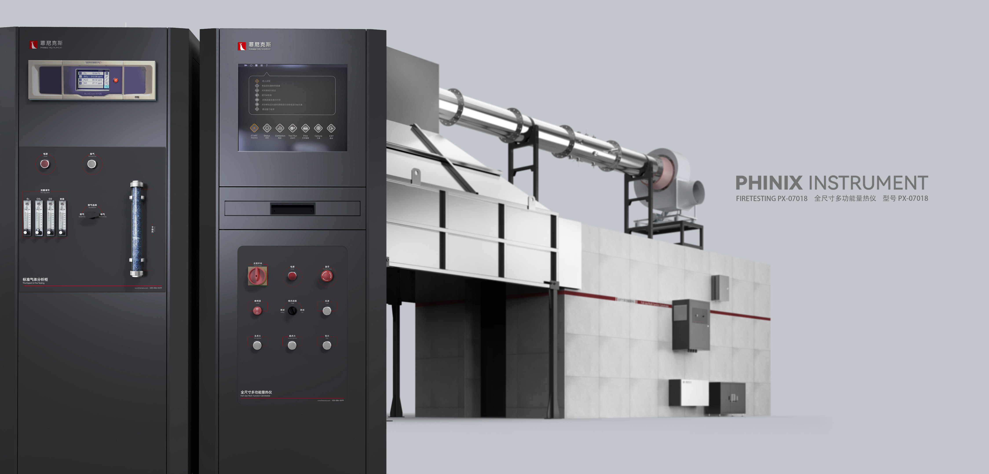
The Expert In Fire Testing
Full Size Multifunctional Calorimeter
The facility provides an independent gas analysis and control platform, including thermal release rate and other related instruments for measurement, such as paramagnetic oxygen sensors, CO2/CO meters, smoke density measurement system, etc.
Built-in temperature sensors, gas flow meters, gas sampling probes and multistage filtration sampling lines ensure long service life of analytical instruments.
LabView software control system under Windows environment can automatically collect and analyze and record complex data. The software can automatically calculate the heat release rate, mass loss rate, smoke density and other related parameters, and give a detailed test report of the product. The device also provides a data printing interface.
Product Standard
Product Parameter
Model PX07018
Test Chamber Cabinet：3.6m×2.4m×2.4m
Exhaust Fume Collecting Hood：3m×3m
Console：650×700×1700mm Two
Power Supply AC 220V, 20A
Weight APPR. 200kg
Gas Source Propane, compressed air
ISO 9705; 1993: Full-scale chamber combustion test
GB/T 27904-2011: Test method for flame ignition performance of furniture and components
Dimension
Feature
The size of the test chamber is L (3.6± 0.2m) ×W (2.4± 0.2m) ×H (2.4± 0.1m), made of brick concrete, steel structure and other A1 or A2 building materials, and the door size is 0.8× 2.0m
The roof of the test chamber has a partial load bearing capacity, the top can be safely installed smoke exhaust pipes, smoke exhaust fans, and personnel can operate and maintain on the top. At the same time design guardrail, stair, and fan installation platform and other facilities.
Equipped with (250mm 10mm)×(250mm 10mm) square igniter as ignition source, made of stainless steel control
The burner is automatically ignited by silicon nitride igniter, and the ignition is stable and reliable.
The size of the stainless steel air collecting hood is 3m×3m, and it is installed above the door of the laboratory. The diameter of the stainless steel exhaust duct is 400mm, and the flow homogenizer device is used before and after the exhaust pipe to make the gas flow evenly.
Equipped with high temperature resistant fan, smoke exhaust capacity is not less than 3.5m³/S. Smoke exhaust fan can be adjusted to ensure that the hood can collect all the smoke; The accuracy of flue gas flowmeter is not less than ±5%, and the response time is not more than 1s
Equipped with 4 imported thermocouples to monitor the temperature in the exhaust pipe, the measurement accuracy is ±0.1℃
Jiangsu Firemana Safety Technology Co., LTD
www.firemana.com
Add: D3 Safe Valley Of China, Tongshan District, Xuzhou City, Jiangsu Province,China
0516-83843888
400-086-0699

Slide 2
The Expert In Fire Testing
Continued Page
High precision MFC control gas flow, safety pipeline system includes check valve, solenoid valve, ball valve, etc., to prevent backfire and can be manually cut off to ensure safety
Equipped with imported light source with color temperature of 2900K, the light source is converted into parallel light beam through the smoke tube through reflector, lens device and focal length adjustment device
By imported silicon optical receiver, the optical signal changes into electrical signal and output, data stability, accuracy
Equipped with standard filter for optical path system calibration
The sampling probe is installed in the sampling pipe of the equipment. The sampling probe is made of stainless steel, which is connected with the sampling pipe through a flange or thread structure and is fixed and sealed. A row of holes are arranged in the center of one side of the sampling control head for sampling, and the sampling holes are away from the direction of wind speed flow to prevent the blockage of combustion dust
The sampling probe is connected to the sampling pump through the PP hose to pump the sampling gas to the gas pretreatment system. The sampling pump pumping volume is 36L/Min, working pressure 7 Kg air pressure (0.7mpa) working vacuum degree -93.1kpa, flow rate 36L/Min
The gas pretreatment system includes filtration system, gas cooling system, gas dehumidification and drying system and gas regulation system.
Equipped with a three-level filter system, the first level filter is used for the cylindrical coarse filter system, used to filter the relatively large particles in the flue gas, prevent the blockage of the pipe and the joint, the filter can be replaced. The secondary filter adopts cup type protection filter, which can filter particles larger than 0.5μm. The filter element device can be replaced. The three-stage filter adopts membrane filter to filter particles larger than 0.2μm.
The cooling system is condensed and dehydrated by condenser and peristaltic pump. The condenser has dual cooling, the stable dew point temperature is about 0.1℃, the outlet temperature is about 5℃. The outlet of peristaltic pump is equipped with condensate collecting box with built-in sponge.
The thermocouple is connected with the pipe by the card sleeve type, which is convenient for disassembly and processing
Equipped with stainless steel two-way probe to measure the wind pressure in the smoke tube, the two ends of the control head are respectively facing the windward and leeward side of the smoke
Equipped with imported differential pressure transmitter to convert pressure signal and output
The dehumidification and drying system uses the air filter tube to place DRIERITE brand anhydrous calcium sulfate for dewatering treatment, and filters the gas moisture to be measured in the air pipe to ensure the drying of the gas entering the analyzer. Anhydrous calcium sulfate can change color after absorbing water, easy observation and easy replacement.
Analysis/calibration switch unit: analyze the cabinet panel has sample gas inlet, standard gas inlet quick plug, and adopts high reliability ball valve, three-way switch valve, easy to field adjustment and maintenance.
Fast bypass: It is equipped with Devere rotor flowmeter for sample gas bypass discharge. The flowmeter is mounted on a panel to ensure that the sample gas flow into the analyzer is 3.5L/Min.
Pressure regulating device: the pressure regulating valve is used to adjust the pressure, and the pressure regulating valve can be adjusted from 0 to 0.4mpa.
Professional HRR test gas analyzer, including O₂, CO₂ :
O₂ : paramagnetic sensor, range 0-25%, accuracy 0.02%, response time T90&lt; 7s
CO₂ : infrared sensor, range 0-10%, accuracy 1%F.s, response time T90&lt; 8S
Support analog output and Modbus RTU and other transmission modes
Computer + professional software control and guide the test process, easy to operate, safe and reliable
Automatic measurement and calculation of material combustion heat release rate (H.R.R), smoke production rate (SPR), oxygen consumption,O₂,CO₂ generation; It can collect and save various data. Screen monitoring and test data preservation can be realized.
Jiangsu Firemana Safety Technology Co., LTD
www.firemana.com
Add: D3 Safe Valley Of China, Tongshan District, Xuzhou City, Jiangsu Province,China
0516-83843888
400-086-0699

