Slide 1
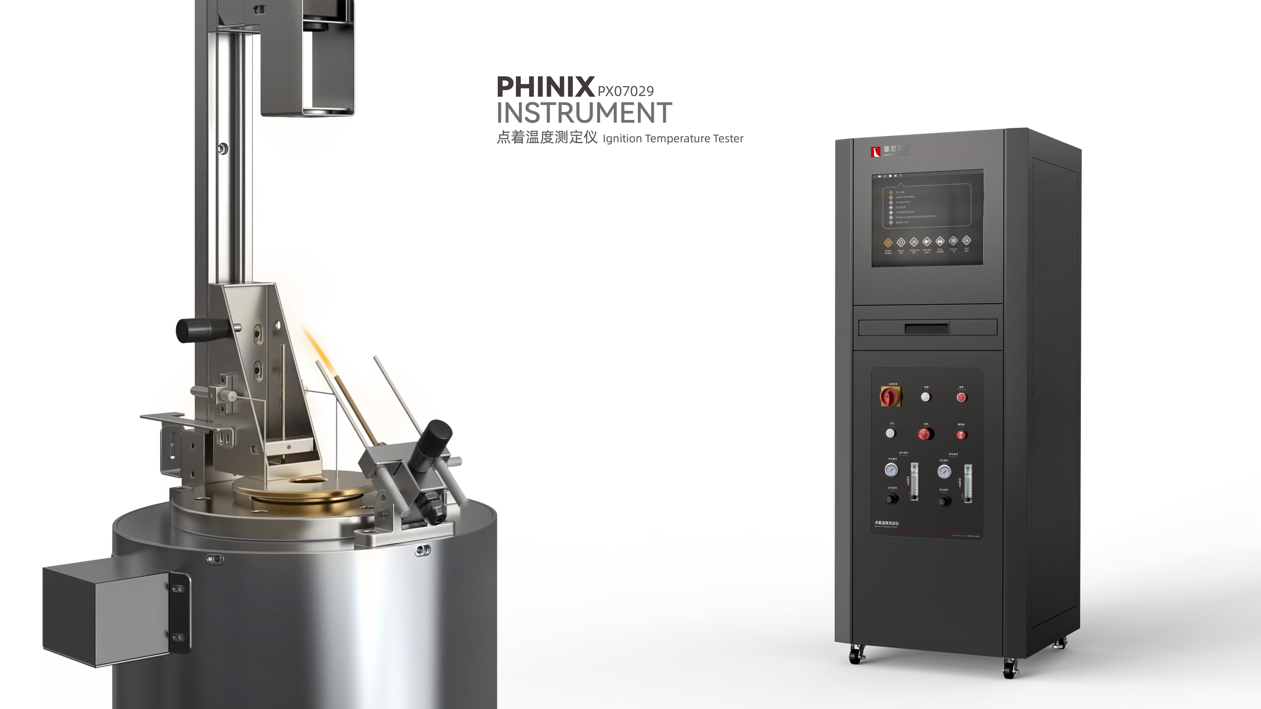
The Expert In Fire Testing
Ignition Temperature Tester
In the heating chamber of the hot air furnace, the sample is heated at different temperatures, and the escaping gas is directly ignited at the opening above the furnace to measure the flashover temperature. Spontaneous combustion temperature is determined by the same method as flash combustion temperature, but no flame is applied.
Product Standard
Product Parameter
GB/T 4610-2008: Determination of ignition temperature by plastic hot air furnace method
Model PX07029
Test furnace:102(W)×1020(D)×4000(H)mm
Console:650（W)×675(D)×1750(H)mm
Power Supply AC220V,15A
Weight APPR.150kg
Gas Source Combustible gas, compressed air
Dimension
Feature
Hot air furnace is made of high temperature resistant corundum tube, inner diameter 100±5mm, length 240mm, by 1.3±0.1mm metal alloy electric heating wire, through the voltage regulator control PID regulation mode can provide more than 750℃ heat source, temperature control accuracy ±1℃
Inner tube furnace diameter 75mm, 240mm high, made of copper material, heat resistance is greater than 750℃
Imported high temperature thermocouple measuring furnace body and furnace temperature, temperature measurement accuracy ±0.1℃
The sample tray has a diameter of 40mm and a depth of 15mm. It is made of high temperature resistant stainless steel. It is connected with the gripper through the stainless steel transmission bar.
The igniter consists of copper tubes with an inner diameter of 2.0mm, and the flame size is adjusted to 20mm±2mm by a precision rotormeter
High pressure pulse automatic ignition, ignition stability and reliability, high security
The fire source device can be adjusted horizontally and 45 degrees to avoid the interference of the refractory partition on the top of the furnace when the sample is taken out
Jiangsu Firemana Safety Technology Co., LTD
www.firemana.com
Add: D3 Safe Valley Of China, Tongshan District, Xuzhou City, Jiangsu Province,China
0516-83843888
400-086-0699

Slide 2
The Expert In Fire Testing
Continued Page
The air source is filtered through the top of the furnace tube and the inner tube, and enters the inner tube from the bottom after heating and circulation between the two tubes
The air source is adjusted by the imported precise rotor flowmeter, and the inlet pressure is regulated and controlled by the brand pressure gauge and regulating valve to provide a stable air source
Stainless steel furnace shell, and furnace tube filled with heat insulation material, to avoid the shell temperature too high.
The self-designed standard electrical cabinet is equipped with Siemens PLC system to achieve functional control. The upper computer software is designed based on NI Labview, with guiding operation, which can record real-time test data, display, save and report output.
The top of the test furnace is equipped with CCD image shooting system, which can be used for real-time monitoring of sample flashover time
The program can automatically generate experimental report and output.
Jiangsu Firemana Safety Technology Co., LTD
www.firemana.com
Add: D3 Safe Valley Of China, Tongshan District, Xuzhou City, Jiangsu Province,China
0516-83843888
400-086-0699

