Slide 1
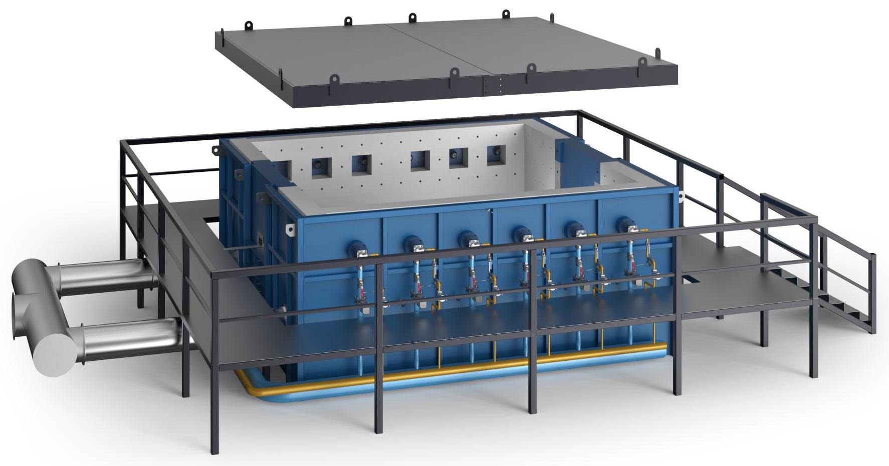
The Expert In Fire Testing
Horizontal Furnace For Fire Resistance Test Of Building Components
The equipment is manufactured in accordance with the technical requirements stipulated in GB/T9978.1-2008. It includes furnace body, test furnace top cover, test steel platform, smoke exhaust air supply system, test control system (including data acquisition system, thermocouple, furnace pressure control system, thermal radiometer, video camera system), integrity measuring instrument, combustion and gas supply system, etc. And with calibration function, to ensure that the temperature and pressure of the value and distribution meet the requirements of the standard.
Product Standard
Product Parameter
GB/T9978.1-2008 "Fire resistance test methods for building elements -- Part 1: General requirements"
ISO834 - "99,GB/T9978.3-2008 "Fire resistance test methods for building elements - Part 3: Notes on the application of test methods and test data" test standard. GB/T9978.5-2008 "Fire resistance test methods for building elements -- Part 5: Particular requirements for load-bearing horizontal dividers" test standard
GB/T14907-2018 "Fire retardant coatings for Steel structures" test standard
Model PX07012
Dimension 8M(W)×8M(L)×2.5M(H)
Power Supply AC380V 70KW
Weight APPR.5 T
Gas Source Liquefied petroleum gas
Feature
Frame structure chamber body, stable structure. The fire brick and high temperature resistant fiber are used for heat insulation treatment to ensure the temperature in the furnace and reduce the damage of high temperature to the surrounding environment
Steel structure platform is set around the furnace body to facilitate the operator to walk.
All exposed components of the test furnace shall be coated to meet the requirements of the corresponding working environment to meet the requirements of corrosion resistance and appearance.
If the burner goes out by itself, the computer will immediately display, sound and light alarm, and automatically cut off the supply of LIQUEFIED petroleum gas to the flameout burner, while other burners are still working normally. Operators can go to the front of the furnace to troubleshoot
The furnace is equipped with pressure relief device and explosion-proof system.
The nozzle is equipped with gas solenoid valve, gas proportional valve, gas ball valve, gas transmitter and other components to ensure the control and monitoring of air intake and ensure the safety of equipment operation
Jiangsu Firemana Safety Technology Co., LTD
www.firemana.com
Add: D3 Safe Valley Of China, Tongshan District, Xuzhou City, Jiangsu Province,China
0516-83843888
400-086-0699

Slide 2
The Expert In Fire Testing
Continued Page
The smoke exhaust pipe of brick and concrete structure can withstand high temperature of combustion
Equipped with high temperature exhaust fan and frequency converter, the waste smoke will be discharged when burning
Furnace temperature monitoring point: 9 temperature points; In the furnace, a TYPE K nickel-chromium-nickel-silicon thermocouple with wire diameter of 2.0MM in accordance with GB/T 16839.1 is adopted. The heat-resistant stainless steel bushing is installed on the outer cover and the heat-resistant material is filled in the middle. The length of the hot end extending out of the bushing is not less than 25MM. Plus or minus 15 ℃
Pressure measurement in furnace: t-shaped probe, measuring accuracy ±2pa. In line with GB/T9978.1-2008 standard, the pressure in the furnace is recorded every 1 min, the accuracy of recording equipment is 1 s. Data were collected 3 times/second. T-shaped measuring probe: USU310S high temperature resistant stainless steel tube, from the furnace through the furnace wall to the furnace, the pressure inside and outside the furnace to maintain the same level. In addition, there is a pressure remote control point for combustion air pressure control point.
Control mode: computer + intelligent instrument and programmable logic controller (PLC) automatic control
The actual temperature rise curve in the furnace can be tracked on the computer screen, and the computer can automatically correct the temperature deviation by quickly and automatically adjusting the size of the burner fire to achieve
All automatic control project data are automatically stored in the computer, you can check the control accuracy anytime and anywhere
Number of burners :12 flat flame proportional burners, 6 on each side. Ar80LPG120k - TS0260/20 m/S,
Operating temperature: maximum test temperature 1250℃, design temperature 1350℃
Combustion mode: low speed proportional flat flame diffused combustion mode, gas and air pressure ≤ 4000Pa, flame length ≤500mm
Equipped with combustion fan to provide air for combustion, equipped with combustion inverter to adjust the fan air supply to achieve the appropriate air-fuel ratio, equipped with air control valve control air intake
The main pipeline is equipped with solenoid valve and ball valve, pressure reducing valve and filter and other components to ensure the overall intake pressure to maintain stability, and quickly cut off the gas supply after the test.
Independent control system, special control elements, used to control the combustion process and fit the combustion curve.
Jiangsu Firemana Safety Technology Co., LTD
www.firemana.com
Add: D3 Safe Valley Of China, Tongshan District, Xuzhou City, Jiangsu Province,China
0516-83843888
400-086-0699

