Slide 1
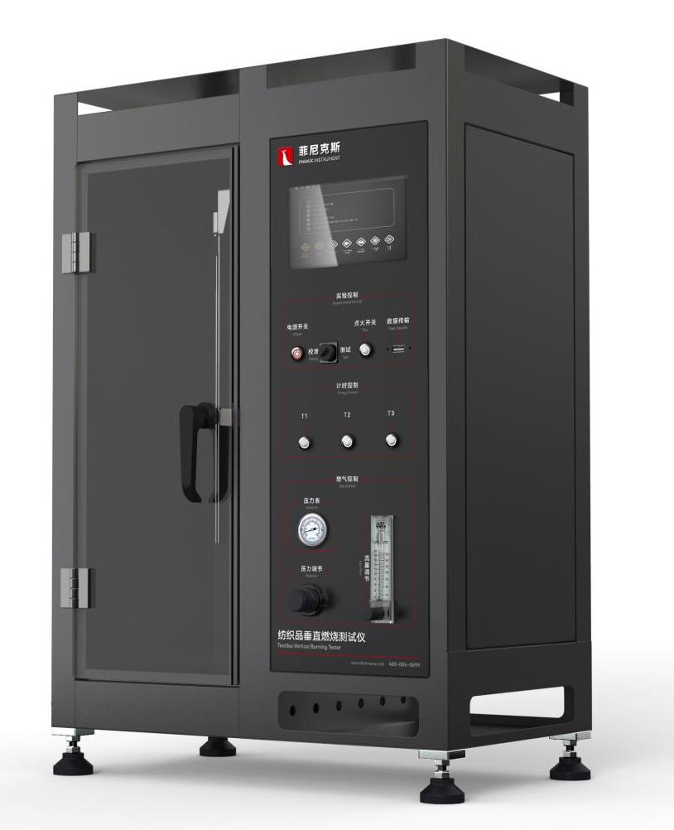
The Expert In Fire Testing
Textiles Vertical Burning Tester
The equipment is manufactured according to the standard test method of flame retardant properties of various flame retardant textiles, used for testing the tendency of continued burning, smouldering and carbonization of textiles. Suitable for flame retardant woven fabrics, knitted fabrics, coating products, laminated products and other flame retardant properties. The principle of the test is: the sample of a certain size will be placed in the specified burner lit, measured after the specified lighting time, the sample continued burning, smouldering time and damage length.
Product Standard
CFR 1615/1616 Children's Pajamas
CA TB117 Flame retardant standard for upholstered Furniture fabrics and fillings
GB/T 5455 Vertical combustion test
GB/T 5725 Safety net 6.1.6 Flame retardant test
ASTM D6413 Vertical combustion method
Product Parameters
Model PX04007
Dimension 580(W)×410(D)×860(H)mm
Power Supply AC 220V,2A
Weight APPR. 40kg
Gas Source Industrial propane or butane
Features
Steel structure chamber, chamber size is 329mm*329mm*767mm, chamber two sides and the top of the layout of 12.5mm air inlet holes and smoke holes.
A large observation window is installed on the front of the box body, and the inner wall of the box is painted in dark color to facilitate the observation of the combustion condition of the sample.
Introduction of industrial design concept of structure, appearance and interface design, integrated panel structure, easy to operate, friendly interface, ergonomic and operating habits, beautiful appearance
High pressure pulse automatic ignition, ignition stability and reliability, high security
Equipped with stainless steel fixture, link structure is easy to clip and take out the sample, positioning needle fixed sample installation stability
Equipped with imported precise rotor flowmeter to control gas flow
Equipped with brand quantity pressure gauge and pressure regulating valve to adjust the gas pressure, equipped with solenoid valve to control the gas on and off, to ensure the safety of equipment.
Jiangsu Firemana Safety Technology Co., LTD
www.firemana.com
Add: D3 Safe Valley Of China, Tongshan District, Xuzhou City, Jiangsu Province,China
0516-83843888
400-086-0699

Slide 2
The Expert In Fire Testing
Continued Page
Equipped with American HUMBOLDT Tyrell fire source, inner diameter of 11±0.3mm, ASTM D5025 standard
The burner is installed on the slide seat and can be sent to the test fire position and back through the electric cylinder.
Programmable logic controller (PLC)+ touch screen control, can realize automatic control/detection/calculation/data storage
Test time, fire time can be set by oneself, with continuous combustion + smouldering + absorbent cotton lighting automatic timing function
Equip with weights, steel rulers and other measuring tools required by the experiment
Jiangsu Firemana Safety Technology Co., LTD
www.firemana.com
Add: D3 Safe Valley Of China, Tongshan District, Xuzhou City, Jiangsu Province,China
0516-83843888
400-086-0699

