Slide 1
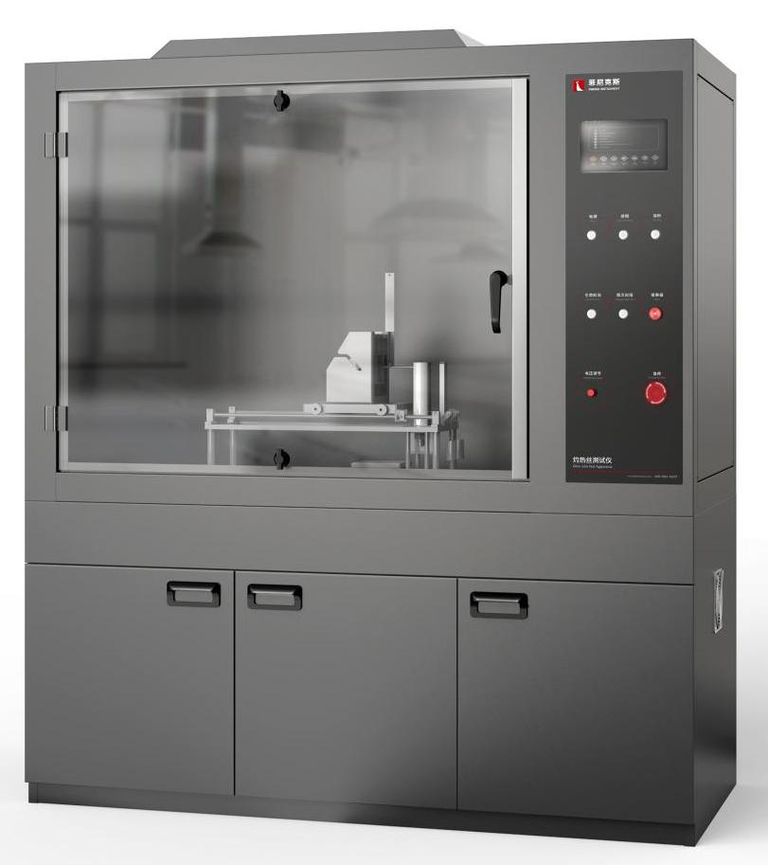
The Expert In Fire Testing
Glow Wire Test Apparatus
Electrical components or parts in failure or overload conditions, may reach too high temperature or ignite their nearby parts, hot wire test simulation of hot elements or overload resistance such as heat source or ignition source in a short time caused by the thermal stress, with simulation technology to assess the risk of fire. Glow-wire test is suitable for electrical and electronic products, household appliances with plastic and non-metallic insulating material parts, such as: switch shell; Relay socket
The glow-wire tester adopts the integrated design of test chamber part and control part, which is convenient for on-site installation and debugging. The important parts are made of stainless steel, resistant to smoke and gas corrosion; Constant current source is used for current regulation to achieve accurate temperature control. Digital display of time and temperature, easy to observe and record, stable and reliable use.
Product Standard
Iec60695-2-10-13, (GB/T5169.10-13-2006) "glow wire/glow wire basic test method, glow wire test device and general test method" and UL 746A, IEC829, DIN695 and other standards.
Product Parameters
Model PX01006
Dimension 1350(W)×700(D)×1000(H)mm
Bottom cabinet 1350(W)×700(D)×650(H)mm
Power Supply AC 220V, 50/60Hz,10A
Weight APPR. 70kg
Features
Steel structure chamber, test chamber volume more than 0.75 cubic meters.
Smoke exhaust device is installed on the top, which can be automatically opened to discharge test exhaust gas after the end of the experiment.
Introduction of industrial design concept of structure, appearance and interface design, integrated panel structure, easy to operate, friendly interface, ergonomic and operating habits, beautiful appearance
Stainless steel fixture, can be installed in different shapes and specifications of the sample
Trolley + code structure, can make the glow-wire probe on the sample of 0.95±0.1N pressure, can control the glow-wire penetration depth of 7±0.5mm
Programmable controller (PLC)+ touch screen control, touch screen automatically set time and time display.
The program automatically records the burning time, ignition time and test burning time, the program automatically timing, time error: ±0.1s.
Jiangsu Firemana Safety Technology Co., LTD
www.firemana.com
Add: D3 Safe Valley Of China, Tongshan District, Xuzhou City, Jiangsu Province,China
0516-83843888
400-086-0699

Slide 2
The Expert In Fire Testing
Continued Page
Constant current heating system, temperature range 500 ~ 1000℃
Temperature error: ±10℃(500 ~ 750℃); Plus or minus 15 ℃ (750 ~ 1000 ℃)
Equipped with φ 1.0mmK type armored thermocouple to measure the glow-wire temperature, measuring range of 0-1000℃, measuring accuracy ±0.1℃.
Equipped with ignition matting of 10mm thick white pine wood
Equipped with silver foil for temperature calibration
Jiangsu Firemana Safety Technology Co., LTD
www.firemana.com
Add: D3 Safe Valley Of China, Tongshan District, Xuzhou City, Jiangsu Province,China
0516-83843888
400-086-0699

