Slide 1
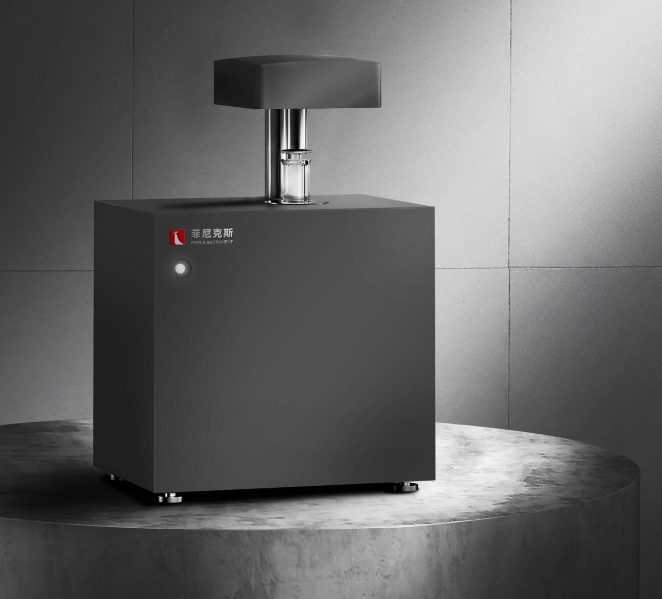
The Expert In Fire Testing
Combustion Calorific Value Tester For Building Materials
The equipment meets the main technical indicators and requirements stipulated in GB/T 14402-2007, and is suitable for measuring the calorific value of combustion of materials in constant heat capacity oxygen bomb calorimeter. Mainly used for flame retardant grade A evaluation of building materials.
Product Standard
GB/T 14402-2007 Flammability of building materials and products -- Determination of the calorific value of combustion
Iso1716-2010 Reaction of building products to flame test. Determination of heat of combustion
Product Parameter
Model PX07004
Dimension 650(L)×390(D)×390(H)mm
Power Supply AC220V，50Hz
Weight APPR. 60kg
Gas Source Oxygen
Feature
The revolutionary representative of calorimeter structure design, the 360-degree full coverage structure of water in the inner cylinder, completely solves the problem of poor long-term stability of the traditional calorimeter (patented technology).
The time of standard method is less than 9 minutes, which is one time higher than the efficiency of traditional calorimeter.
Equipped with independent cold water station, with high precision temperature control device, to ensure that the temperature control error of the outer bucket is ±0.005℃.
Adapt to the requirements of high strength test, can work continuously.
Using laser ignition technology, stable ignition success rate, improve measurement accuracy, easy to operate (patented technology). No ignition wire, no cotton
Jiangsu Firemana Safety Technology Co., LTD
www.firemana.com
Add: D3 Safe Valley Of China, Tongshan District, Xuzhou City, Jiangsu Province,China
0516-83843888
400-086-0699

Slide 2
The Expert In Fire Testing
Continued Page
With automatic oxygenation function, oxygenation automatic timing, automatic stop.
With safety protection device, when the oxygen pressure exceeds 3.2mpa, it will automatically deflate and return to the safe pressure.
Jiangsu Firemana Safety Technology Co., LTD
www.firemana.com
Add: D3 Safe Valley Of China, Tongshan District, Xuzhou City, Jiangsu Province,China
0516-83843888
400-086-0699

