Slide 1
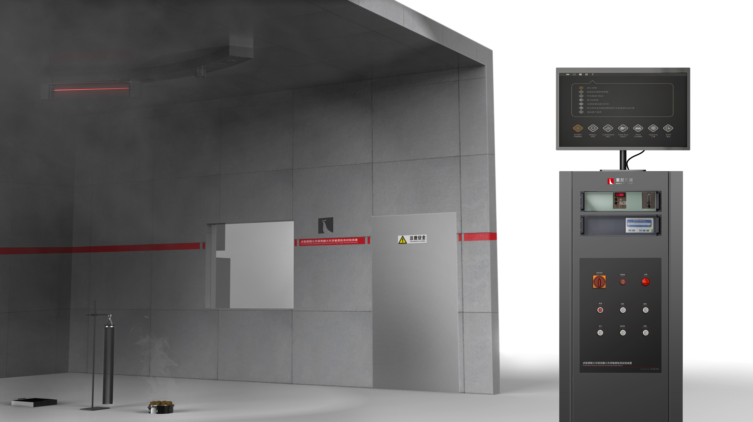
The Expert In Fire Testing
Fire Sensitivity Test System
This equipment is in line with GB 4715-2005, applicable to the general industrial and civil buildings installed in the scattered light, transmission light working principle of point type optical inductor smoke fire detector and ionization principle of point type ion smoke fire detector sensitivity test.
Product Standard
Product Parameter
GB4715 "Technical requirements and test methods for Point type smoke fire detector"
ISO7240-7
Model PX08004
Console：600(W)×650(D)×1200(H)mm
Test Chamber：10000(W)×7000(D)×4000(H)mm
Power Supply AC220V 7.5KW
Weight 400kg
Dimension
Feature
Room size 10m x 7m x 4.2m, interior black latex paint
A 1m x 1m x 5mm iron plate is placed in the center of the laboratory to protect the ground.
Required laboratory temperature 15 ~35℃, humidity: 25%~75%RH
The smoke exhaust equipment is composed of an air collecting hood, a butterfly valve, an exhaust fan, and a smoke exhaust pipe. The end of the smoke exhaust pipe is connected with the main smoke exhaust pipe of the system.
The smoke hood and exhaust pipe are made of SUS304, and the smoke hood is installed on the top of the laboratory
Equipment according to the requirements of the standard to provide the following 4 fire source devices:
Sh3-polyurethane plastic fire: fuel: mass density of about 20kg/m³ non-flame retardant homogeneous polyurethane foam; Layout: 3 50cm×50cm×2cm pads are stacked together, the bottom plate is aluminum foil, and its edges are rolled inward; Ignition fuel: add 5mL methylated alcohol into a disk with a diameter of 5cm; Ignition method: manual ignition method is adopted to ignite alcohol in the corner of the bottom pad
Sh4-n-heptane fire: fuel: n-heptane (purity & GT; =99%) + 3% toluene (purity 99%) 650g; Layout: placed in a container of 1100 square centimeters (33cm×33cm) in degree and 5cm height made of 2mm thick steel plate; Ignition method: manual ignition with long handle igniter;
The imported OMEGA K thermocouple is used to measure the temperature of the electric heating plate. The temperature range is 0~1100℃ and the accuracy is 0.1℃
Jiangsu Firemana Safety Technology Co., LTD
www.firemana.com
Add: D3 Safe Valley Of China, Tongshan District, Xuzhou City, Jiangsu Province,China
0516-83843888
400-086-0699

Slide 2
The Expert In Fire Testing
Continued Page
SH1- Wood pyrolytic smouldering fire: 10 75×25×20mm beech sticks (approximately 5% water content) placed radially on a heating plate. Heating plate: rated power 2KW, diameter 220mm on the heating plate
SH2- Cotton rope smouldering fire: Fuel: clean, dry cotton rope, 80m long, 3g weight, 90 support: metal ring and support with diameter of 10CM. Ignition method: manual ignition
Equipped with 8.2kg range, accuracy 0.1g of the electronic scale to measure fuel weight
Equipped with German ALM-F fire laboratory special optical density meter, resolution 0.001dB/m, accuracy +/-0.001dB/m
MIC ion concentration meter was selected
The electric heating plate control system is composed of programmable logic controller (PLC), expansion module, power regulator and thermocouple, which can raise the temperature of the electric heating plate to 600℃ and stabilize in 11 minutes.
Computer + professional software control test operation, guide the test process, and real-time display test data, save query.
Jiangsu Firemana Safety Technology Co., LTD
www.firemana.com
Add: D3 Safe Valley Of China, Tongshan District, Xuzhou City, Jiangsu Province,China
0516-83843888
400-086-0699

