Slide 1
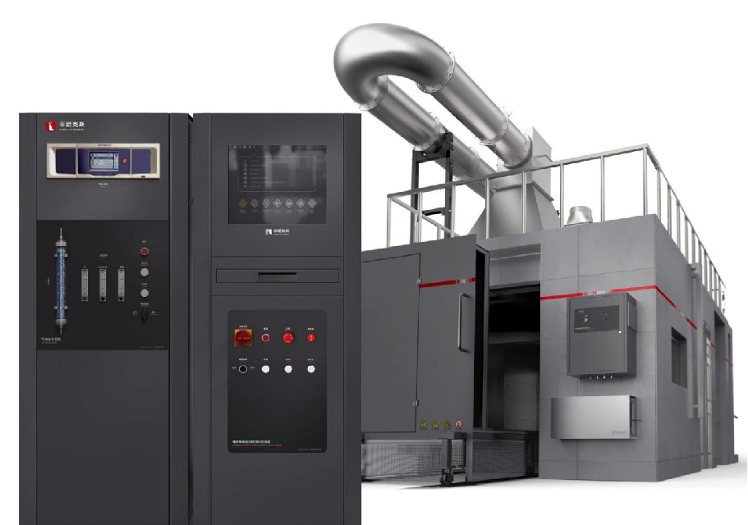
The Expert In Fire Testing
Building Materials Monomer Product Combustion Tester
The SBI test method is used to test the fire resistance of building material products (except flooring materials) when exposed to heat. The experimental principle is to calculate the heat release rate at a certain time by measuring the change of oxygen concentration during the test, as well as the flue gas flow and CO2 concentration in the pipeline, and then measure the maximum heat release rate and time during the test, namely the FIGRA index of heat release rate. The index is used to grade the combustion performance of GB8624 building materials and products.
Product Parameter
Product Standard
Model PX07001
Combustion Chamber：3000(W)×3000(D)×2400(H)mm（Inner）
Console：650(W)×675(D)×1750(H)mm
Standard Gas Analysis Cabinet: 650(W)×675(D)×1750(H)mm
Power Supply AC 220V AC 380V, 50/60Hz
Weight APPR.80kg
Gas Source Propane with purity above 95%,standard gas
GB/T 20284-2006 Single combustion test for building materials or products
BS EN 13823: Determination of building materials (excluding flooring materials) by single combustion Apparatus (SBI)
Performance under attack of monomer combustion heat
Dimension
Feature
Test Chamber size (3.0± 0.2m) * (3.0± 0.2m), height 2.4± 0.1m, brick concrete, steel structure and other A1 or A2 building materials
The top of the test chamber has a partial load-bearing capacity. The top can safely set up smoke exhaust pipes and fans, and the personnel can operate and maintain on the top. At the same time, the facilities such as guardrail, stairs and fan installation platform are designed
A push door is set on the front of the test chamber, and a fire door is set on the side to enter the test chamber to check the installation state of the sample. The side and back are provided with observation Windows to observe the combustion state
It is equipped with two main and auxiliary burners. The main burner is mounted on the cart for combustion test, and the auxiliary burner is mounted on the frame for benchmark measurement of heat release rate
The burner is made of stainless steel plate and is a right triangle with a side length of 250mm and a height of 80mm. It is filled with sand and stone diffusion gas and can produce 30.7±2KW heat output
The burner is automatically ignited by silicon nitride igniter, and the ignition is stable and reliable
High precision MFC control gas flow, safety pipeline system includes check valve, solenoid valve, ball valve, etc., to prevent backfire and can be manually cut off to ensure safety
Jiangsu Firemana Safety Technology Co., LTD
www.firemana.com
Add: D3 Safe Valley Of China, Tongshan District, Xuzhou City, Jiangsu Province,China
0516-83843888
400-086-0699

Slide 2
The Expert In Fire Testing
Continued Page
The frame is made of square steel with calcium calcium plate mounted on the inner surface to prevent direct flame impact and improve service life
Steel structure test cart, laid calcium silicate plate on the inner surface to prevent direct flame impact to improve service life
U-shaped slot and C-shaped clip are mounted on the cart for mounting long wing and short wing samples
The cart is installed on the guide rail, facilitating the stability and position fixing of the push
Equipped with 4 imported thermocouples to monitor the temperature in the exhaust pipe, the measurement accuracy is ±0.1℃
The thermocouple is connected with the pipe by clamp sleeve, which is convenient for disassembly and replacement
Equipped with stainless steel two-way probe to measure the wind pressure in the smoke tube, the two ends of the control head are respectively facing the windward and leeward side of the smoke
Equipped with imported differential pressure transmitter to convert pressure signal and output
Equipped with imported light source, through the lens device, the focal length adjustment device will be converted into parallel light beam through the smoke tube
By imported silicon optical receiver, the optical signal changes into electrical signal and output, data stability, accuracy
Equipped with standard filter for optical path system calibration
The sampling probe is installed in the sampling pipe of the equipment. The sampling probe is made of stainless steel, which is connected with the sampling pipe through a flange or thread structure and is fixed and sealed. A row of holes are arranged in the center of one side of the sampling control head for sampling, and the sampling holes are away from the direction of wind speed flow to prevent the blockage of combustion dust
The main and auxiliary burner air sources switch automatically during calibration and testing
Stainless steel gas collecting hood, collector, stainless steel J-type smoke exhaust pipe, inner diameter of 315±5mm heat insulation round pipe, with 50mm thick high temperature resistant mineral wool insulation; The front and back of the acquisition system are used to equalize the flow of gas.
High temperature fan is equipped to extract combustion exhaust gas in the laboratory, and the volume flow rate in the exhaust pipe is controlled by frequency converter to be 0.5-0.65 cubic meters /S
The dehumidification and drying system uses the air filter tube to place DRIERITE brand anhydrous calcium sulfate for dewatering treatment, and filters the gas moisture to be measured in the air pipe to ensure the drying of the gas entering the analyzer. Anhydrous calcium sulfate can change color after absorbing water, easy observation and easy replacement.
Analysis/calibration switch unit: analyze the cabinet panel has sample gas inlet, standard gas inlet quick plug, and adopts high reliability ball valve, three-way switch valve, easy to field adjustment and maintenance.
Fast bypass: It is equipped with Devere rotor flowmeter for sample gas bypass discharge. The flowmeter is mounted on a panel to ensure that the sample gas flow into the analyzer is 3.5L/Min.
Pressure regulating device: the pressure regulating valve is used to adjust the pressure, and the pressure regulating valve can be adjusted from 0 to 0.4mpa.
Professional HRR test gas analyzer, including O₂, CO₂:
O₂ : paramagnetic sensor, range 0-25%, accuracy 0.02%, response time T90&lt; 7s
CO₂ : infrared sensor, range 0-10%, accuracy 1%F.s, response time T90&lt; 8S
Jiangsu Firemana Safety Technology Co., LTD
www.firemana.com
Add: D3 Safe Valley Of China, Tongshan District, Xuzhou City, Jiangsu Province,China
0516-83843888
400-086-0699

Slide 3
The Expert In Fire Testing
Continued Page
The sampling probe is connected to the sampling pump through the PP hose to pump the sampling gas to the gas pretreatment system. The sampling pump pumping volume is 36L/Min, working pressure 7 Kg air pressure (0.7mpa) working vacuum degree -93.1kpa, flow rate 36L/Min.
The gas pretreatment system includes filtration system, gas cooling system, gas dehumidification and drying system and gas regulation system.
Equipped with a three-level filtration system, the first level of filtration is the cylinder coarse filtration system, used to filter the relatively large particles in the flue gas, prevent the blockage of pipes and joints, the filter can be replaced. The secondary filter adopts cup type protective filter to filter particles larger than 0.5μm in size. The filter element device can be replaced. The three-stage filter adopts membrane filter to filter particles larger than 0.2μm.
The cooling system is condensed and dehydrated by condenser and peristaltic pump. The condenser has dual cooling, the stable dew point temperature is about 0.1℃, the outlet temperature is about 5℃. The outlet of peristaltic pump is equipped with condensate collecting box with built-in sponge.
Support analog output and Modbus RTU and other transmission modes
Computer + professional software control and guide the experimental process, easy to operate, safe and reliable
Automatic measurement and calculation of material combustion heat release rate (H.R.R), smoke production rate (SPR), oxygen consumption,O₂,CO₂ generation; It can collect and save various data. Screen monitoring and test data preservation can be realized.
KC device is optional, equipped with pitot tube, two-way control head
Jiangsu Firemana Safety Technology Co., LTD
www.firemana.com
Add: D3 Safe Valley Of China, Tongshan District, Xuzhou City, Jiangsu Province,China
0516-83843888
400-086-0699

