Slide 1
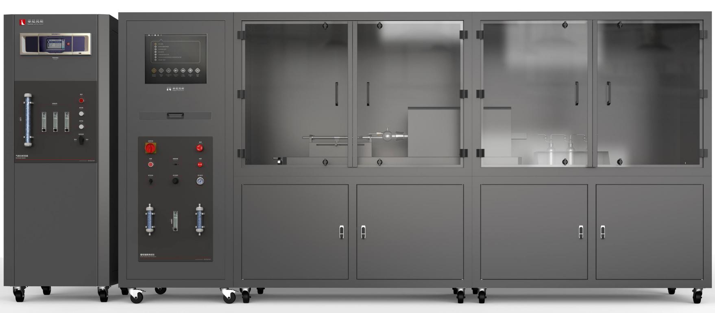
The Expert In Fire Testing
Smoke Toxicity Index Test Apparatus
Toxicity index tester is used for flue gas toxicity test of EN 50305 and BS 6853 Appendix B. In the test, a certain flow of flue gas is sent into standard adsorption solution for absorption, or collected by air bag for further analysis and use
Product Standard
Product Parameters
EN 50305: British cable standard
BS 6853 Appendix B: Toxicity test criteria
ISO 19700: Fire stream toxicity tests - Method for steady-state tubular furnaces
Model PX01011
Equipment：3600(W)×900(D)×1800(H)mm
Gas analysis Chamber：650(W)×680(D)×1800(H)mm
Power Supply AC 220V,25A
Weight APPR. 550kg
Gas Source The Compressed air
Dimension
Features
Sealed chamber, flue gas generation device installed in the chamber, clean interface, can protect the operation of equipment; Large viewing window facilitates the operation of equipment.
Introduction of industrial design concept of structure, appearance and interface design, integrated panel structure, easy to operate, friendly interface, ergonomic and operating habits, beautiful appearance
Tube furnace heating, the length is 600mm, automatic adjustment to make the furnace body uniform temperature rise to the target temperature; Tube furnace with mesh shell protection, can effectively heat; High temperature K type thermocouple measurement sample area temperature, measurement range 0-1100℃, measurement accuracy ±0.1℃.
Equipped with two filtration columns, respectively filled with activated carbon and color-changing silica gel, to clean and dry carrier gas
Equipped with two filtration columns, respectively filled with activated carbon and color-changing silica gel, to clean and dry carrier gas
Toxic gas component discontinuous analysis system equipped with imported gas acquisition bag, imported colorimetric tube; SO2: measurement range: 0-1000ppm, resolution 1ppm, accuracy 30ppm; NOX: Measurement range: 0-3000ppm, resolution 1ppm, accuracy 30ppm
Jiangsu Firemana Safety Technology Co., LTD
www.firemana.com
Add: D3 Safe Valley Of China, Tongshan District, Xuzhou City, Jiangsu Province,China
0516-83843888
400-086-0699

Slide 2
The Expert In Fire Testing
Continued Page
Quartz tubes made of more than 2mm heat-resistant quartz are used for gas transmission and sample heating, and the tube joints are frosted to increase sealing performance
The ceramic combustion boat is controlled by strong magnetic and drive strip, which can stably transfer the measured material to the measuring area of the furnace core
Screw drive mechanism can shift the traction tube to quartz sealing, precise positioning, smooth operation to avoid quartz tube damage caused by human factors
Toxic gas discontinuous analysis system :(ultraviolet spectrophotometer) (optional)
HCN: Spectral analysis equipment: spectral analyzer with wavelength of 500nm, permeable film thickness of 10mm
Reagents: Gaseous bubble absorbing solution 0.1N NaOH
Titration reagents: picric acid aqueous solution with a concentration of 3g/dm3 and sodium carbonate aqueous solution with a concentration of 50g/dm3
Brand computer + professional operating software automatic control test process
Temperature control and stability are automatically controlled by software, which records and forms curves
Test data is automatically displayed, stored and reported
Gas sampling bag PTFE coated, 80L with imported manual sampler
Optional online infrared gas analyzer and gas pretreatment system:
CO: measurement range: 0 ~ 10%; Resolution: 0.01%, accuracy: absolute ±0.1% or relative 3%.
CO₂ : measurement range: 0 ~ 20%; Resolution: 0.01%, accuracy: absolute ±0.2% or relative 3%
Jiangsu Firemana Safety Technology Co., LTD
www.firemana.com
Add: D3 Safe Valley Of China, Tongshan District, Xuzhou City, Jiangsu Province,China
0516-83843888
400-086-0699

