Slide 1
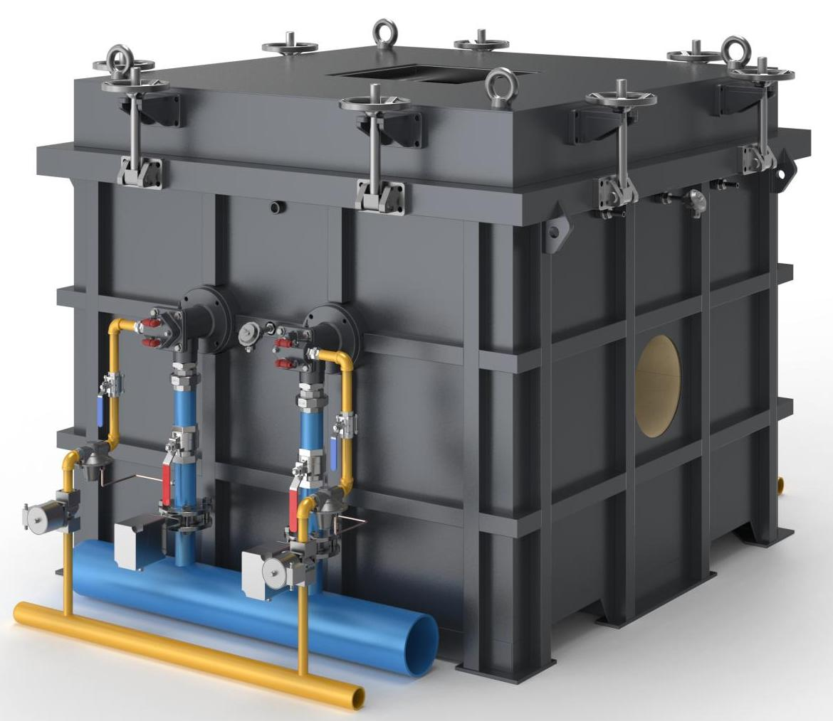
The Expert In Fire Testing
Fire Resistance Test Equipment For Fireproof Coating Of Steel Structure
Steel structure fire retardant coating heat insulation efficiency and fire resistance limit test furnace is according to the national standard GB14907-2018 "Steel structure fire retardant coating", GB/T9978-2008 fourth, fifth 5.1 and 5.2 stipulated in the technical indicators developed for the fire resistance test of steel structure fire retardant coating special instrument. High degree of automation, accurate test data.
Product Standard
Gb14907-2018 Steel Structure fire Retardant Coating
GB/T9978-2008 Fire resistance test method for building elements
Product Parameter
Model PX07036
Furnace Dimension 2500(W)×2500(D)×1500(H)mm
Console Dimension 700(W)×400(D)×1700(H)mm
Power Supply AC220V/AC380V，120A,50Hz
Weight APPR. 1000kg
Feature
Frame structure chamber body, stable structure. Internal heat resistant and heat resistant fiber heat insulation treatment, to ensure the temperature in the furnace and reduce high temperature damage to the surrounding environment
The furnace cover adopts spiral locking mode, convenient operation, reliable locking effect; The furnace cover is installed with a lifting ring, which is convenient for lifting when in use
Equipped with imported nozzle burner control system, the burner power is 230KW to produce jet fire for heating in the furnace
The nozzle is equipped with gas solenoid valve, gas proportional valve, gas ball valve, gas transmitter and other components to ensure the control and monitoring of air intake and ensure the safety of equipment operation
Independent control system, special control elements, used to control the combustion process and fit the combustion curve.
The smoke exhaust pipe of brick and concrete structure can withstand high temperature of combustion
Equipped with high temperature exhaust fan and frequency converter, the waste smoke will be discharged when burning
Temperature acquisition system uses programmable logic controller (PLC) and temperature acquisition module to realize real-time temperature acquisition through imported thermocouple
Internal thermocouple 0.5mm thermocouple, display precision 0.1℃
The thermocouple in the furnace shall be k-type thermocouple with wire diameter of 2.2mm, and the length of the hot end extending out of the casing shall not be less than 25mm
Jiangsu Firemana Safety Technology Co., LTD
www.firemana.com
Add: D3 Safe Valley Of China, Tongshan District, Xuzhou City, Jiangsu Province,China
0516-83843888
400-086-0699

Slide 2
The Expert In Fire Testing
Continued Page
Equipped with combustion fan to provide air for combustion, equipped with combustion inverter to adjust the fan air supply to achieve the appropriate air-fuel ratio, equipped with air control valve control air intake
The main pipeline is equipped with solenoid valve and ball valve, pressure reducing valve and filter components, to ensure the overall intake pressure to maintain stability, quickly cut off the gas supply after the test.
Adopt imported differential pressure sensor, measuring range -50~50Pa, accuracy ± 1%F.s
Equipped with standard small cabinet control box, built-in water cooling system to realize automatic coolant circulation and cooling function, to ensure the stability and reliability of heat flow meter data
Thermopile heat flow meter is adopted, measuring range 0-50kW/m², accuracy ±3%, repeatability ±0.5%. The radiation receiving target is water-cooled, 12.5mm in diameter, and covered with a durable dull black coating.
Computer + professional software control experiment operation, through the form of man-machine dialogue, set the furnace manual parameters, the computer according to the set parameters for automatic adjustment.
Backfire thermocouple diameter is 0.5mm, low temperature welding or welding on the thickness of 0.2mm, diameter of 12mm round copper sheet
Environmental thermocouple is stainless steel armored thermocouple with outer diameter of 3mm
The diameter of the mobile thermocouple is 1mm, and it is welded or fused at low temperature on the round copper sheet with thickness of 0.5mm and diameter of 12mm
The pressure in the furnace is measured by the t-type static pressure control tube inserted into the furnace body. The control tube is made of 304 stainless steel with an inner diameter of 6mm.
The whole production process flow, pressure, temperature, air-fuel ratio, load parameters, such as industrial PC, and displayed on the software, may at any time to review all sorts of historical archives or at the same time according to user requirements to print all kinds of production reports, sound and light alarm system can timely to alarm, fault, wrong operation and prompt treatment to the operators. The system is easy to operate, reliable to run and simple to maintain
Before ignition, the burner has automatic detection of gas pipeline and valve leakage program, automatic purge program, automatic ignition program control, and gas, air pressure abnormal alarm and interlock and other safety protection measures.
Jiangsu Firemana Safety Technology Co., LTD
www.firemana.com
Add: D3 Safe Valley Of China, Tongshan District, Xuzhou City, Jiangsu Province,China
0516-83843888
400-086-0699

