Slide 1
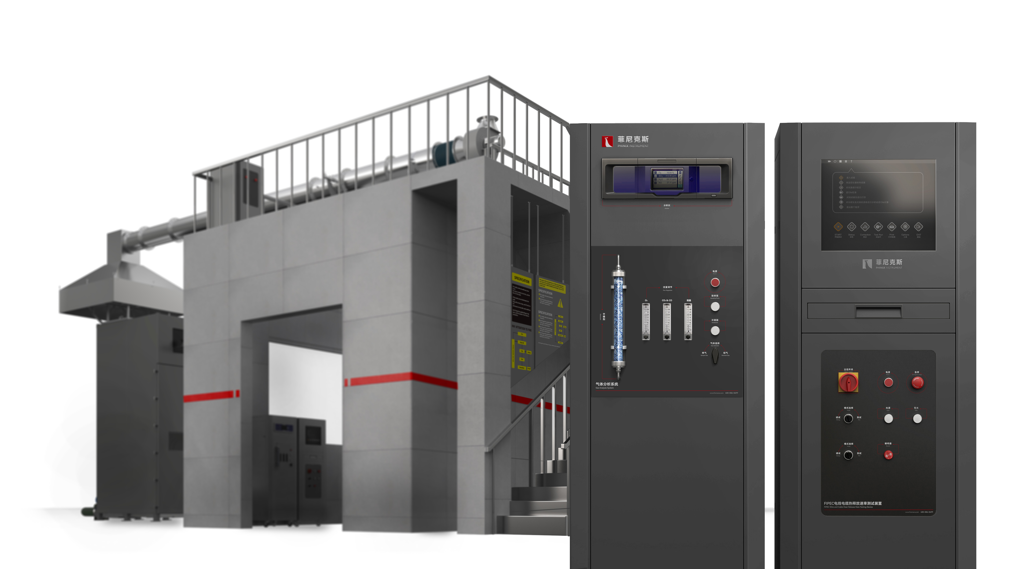
The Expert In Fire Testing
FIPEC Wire And Cable Heat Release Rate Testing Device
This standard specifies the test apparatus and test method for evaluating the flame spread, heat release and smoke generation characteristics of vertically installed bundled wires, cables or optical cables under specific test conditions. The experiment can obtain the flame spread (FS), heat release rate (HRR), total heat release (THR), smoke production rate (SPR), total smoke production (TSP), and combustion growth of cables or optical cables under specific combustion conditions. Rate index (FIGRA), and characteristics such as burning drips/particulates
Product Standard
Product Parameter
GB/T 31248-2014 Characteristics of flame spread, heat release and smoke generation of cables or optical cables under fire conditions.
EN 50399 Test of heat release and smoke generation characteristics of cables in flame propagation test.
Model PX02018
Combustion chamber：1600(W)*2500(D)*5600(H)
Control chamber：650(W)*650(D)*1600(H)
Gas Analysis Chamber：650(W)*650(D)*1600(H)
Power Supply AC220V 10A，AC 380V,30A 50Hz
Weight APPR. 1500kg
Gas Source Propane With Purity Above 95%
Dimension
Feature
Steel structure combustion chamber, the inner wall is stainless steel plate, filled with mineral wool for thermal insulation
The front end of the combustion chamber is installed with a steel structure door that can be opened and sealed, and the door is equipped with a fire-resistant tempered glass observation window
Independent electric control cabinet, convenient for on-site layout arrangement
Ribbon propane burner blowtorch with imported venturi mixer
In the air supply section, an adjustable-speed blower and a frequency converter are used to control the air inlet flow rate, and the intake air volume is measured by a pitot tube and a differential pressure sensor.
The upper part of the test box is equipped with a pitot tube and a differential pressure sensor for wind speed measurement to ensure the test wind speed.
The stainless steel gas collecting hood is installed directly above the experimental box, the diameter of the stainless steel flue is 400mm, and the flow equalizer device is used in the front and back of the flue gas pipe to make the gas flow evenly.
Jiangsu Firemana Safety Technology Co., LTD
www.firemana.com
Add: D3 Safe Valley Of China, Tongshan District, Xuzhou City, Jiangsu Province,China
0516-83843888
400-086-0699

Slide 2
The Expert In Fire Testing
Continued Page
Equipped with high-precision MFC to control the feeding amount of gas and air, and mixed by Venturi, so that the burner can provide a stable fire source
Equipped with a silicon nitride ignition device, the ignition is stable and reliable.
Automatic flameout protection device, programmable logic controller (PLC) + MFC realizes automatic control of propane and air supply sequence during ignition and flameout
Equipped with an all-stainless steel movable trolley, which is used to place and adjust the test position of the torch, which is convenient to use.
Equipped with stainless steel two-way probe to measure the wind pressure in the smoke pipe, the two ends of the control head are facing the windward side and the leeward side of the flue gas respectively
Equipped with imported differential pressure transmitter to convert pressure signal and output
Equipped with an imported light source with a color temperature of 2900k, the light source is converted into a parallel light beam through the cigarette pipe through the lens device and the focal length adjustment device
The optical signal changes are converted into electrical signals by imported silicon optical receivers and output, the data is stable and accurate
Equipped with standard filters for calibration of the optical path system
The sampling smoke pipe of the equipment has a built-in sampling probe. The sampling probe is made of stainless steel. It is connected to the sampling smoke pipe through a flange or threaded structure and is fixed and sealed. A row of small holes is arranged in the center of one side of the sampling probe for sampling, and the sampling holes are facing the direction of the flow of wind speed to prevent the clogging of combustion dust.
Equipped with a high temperature resistant fan, the smoke exhaust capacity is not less than 1.5m³/S. The speed of the exhaust fan can be adjusted to ensure that the fume hood can collect all the flue gas; the accuracy of the flue gas flow meter is not less than ±5%, and the response time is not more than 1s
Equipped with 4 imported thermocouples for temperature monitoring in the exhaust pipe, the measurement accuracy is ±0.1℃
The thermocouple and the pipeline are connected by a sleeve, which is convenient for disassembly and handling.
The dehumidification and drying system adopts the DRIERITE brand anhydrous calcium sulfate in the air filter tube for water removal treatment, and filters the moisture of the gas to be measured in the air tube to ensure the drying of the gas entering the analyzer. Anhydrous calcium sulfate can change color after absorbing water, easy to observe and easy to replace.
Analysis/calibration switching unit: There are quick plugs for sample gas inlet and standard gas inlet on the panel of the analysis cabinet, and high-reliability ball valves and three-way switching valves are used for easy on-site adjustment and maintenance.
Quick bypass: Equipped with a Dwell rotameter for sample gas bypass evacuation. The flowmeter is panel-mounted to ensure that the sample gas flow into the analyzer is 3.5L/Min.
Pressure regulating device: The pressure regulating valve is used for pressure regulation, and the pressure of the pressure regulating valve is adjustable at 0-0.4Mpa.
Professional HRR test gas analyzer, including O₂, CO₂
O₂: Paramagnetic sensor, range 0-25%, accuracy 0.02%, response time T90<7s
CO₂: infrared sensor, range 0-10%, accuracy 1%F.S, response time T90<8S
Jiangsu Firemana Safety Technology Co., LTD
www.firemana.com
Add: D3 Safe Valley Of China, Tongshan District, Xuzhou City, Jiangsu Province,China
0516-83843888
400-086-0699

Slide 3
The Expert In Fire Testing
Continued Page
The sampling probe is connected to the sampling pump through the PP hose to extract the sample gas and deliver it to the gas pretreatment system. The suction volume of the sampling pump is 36L/Min, the working pressure is 7Kg air pressure (0.7MPA), the working vacuum degree is -93.1KPa, and the flow rate is 36 L/min.
The gas pretreatment system includes a filtration system, a gas cooling system, a gas dehumidification and drying system, and a gas conditioning system.
Equipped with a three-stage filter system, the first-stage filter adopts a cartridge-type coarse filter system, which is used to filter the relatively large particles in the flue gas to prevent clogging of the pipes and joints, and the filter can be replaced. The secondary filter adopts a cup-type protection filter to filter particles larger than 0.5μm, and the filter element device can be replaced. The tertiary filter uses a membrane filter to filter particles larger than 0.2 μm in size.
The cooling system is condensed and dewatered by a condenser and a peristaltic pump. The condenser is equipped with two-way cooling, the dew point stabilization temperature is about 0.1°C, and the outlet air temperature is about 5°C. The peristaltic pump outlet is equipped with a condensate collection box with a built-in sponge.
Supports multiple transmission methods such as analog output and Modbus RTU
Computer + professional software control, can guide the experimental process, easy to operate, safe and reliable
Automatically measure and calculate the heat release rate (H.R.R), smoke production rate (SPR), oxygen consumption, O₂, CO₂ generation of material combustion; various data collection and storage can be performed; screen monitoring and test data storage can be realized.
CO₂: infrared sensor, range 0-10%, accuracy 1%F.S, response time T90<8S
Supports multiple transmission methods such as analog output and Modbus RTU
Computer + professional software control, can guide the experimental process, easy to operate, safe and reliable
Automatically measure and calculate the heat release rate (H.R.R), smoke production rate (SPR), oxygen consumption, O₂, CO₂ generation of material combustion; various data collection and storage can be performed; screen monitoring and test data storage can be realized.
Jiangsu Firemana Safety Technology Co., LTD
www.firemana.com
Add: D3 Safe Valley Of China, Tongshan District, Xuzhou City, Jiangsu Province,China
0516-83843888
400-086-0699

