Slide 1
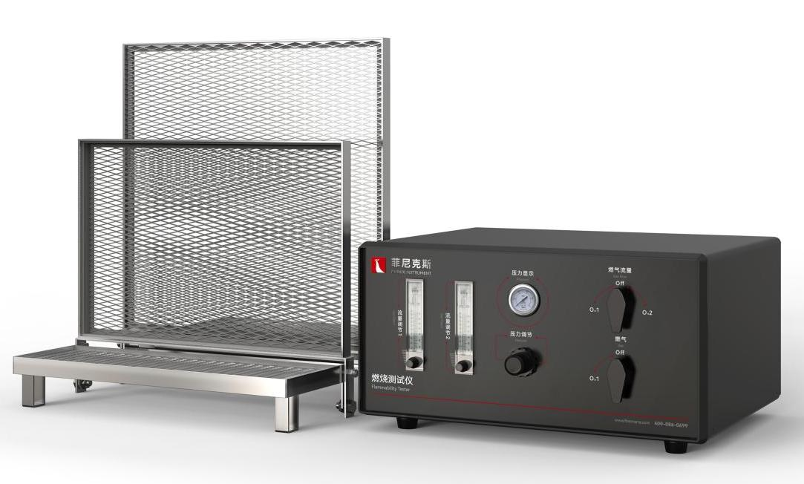
The Expert In Fire Testing
BS 5852 Flammability Tester
Widely used in Europe and the United States of America upholstered furniture flame retardant performance measurement, with 0-7 fire source and standard fabric and sponge, etc., to test the combustion performance.
Product Standard
Product Parameters
Model PX04013
Table chair framework：450×300×150mm
Backrest framework：450×450×300mm
Control Cabinet: 500(W)×400(D)×250(H)mm
Power Supply None
Weight APPR. 20kg
Gas Source Cigarette, wood stack, propane with 95% purity
UK Regulation: British standard
BS 5852: British Standard for testing the flammability of furniture Fabrics
CFR 1634: American standard for fire testing of upholstered furniture
Dimension
Features
Equipped with all stainless steel sample rack, the size of the large sample rack is 450×450×300mm, the size of the small sample rack is 450×300×150mm, composed of stainless steel diamond net.
Independent gas control cabinet, by precise imported brand rotor flowmeter control source gas flow
By the brand pressure gauge and control valve control source gas pressure, by the ball valve control gas on and off as well as the choice of gas path
The ignition tube made of stainless steel, the outer diameter of 8±0.1mm, the inner diameter of 6.5±0.1mm, the length of 200±5mm, can provide the standard requirements of 1,2,3 fire source
Jiangsu Firemana Safety Technology Co., LTD
www.firemana.com
Add: D3 Safe Valley Of China, Tongshan District, Xuzhou City, Jiangsu Province,China
0516-83843888
400-086-0699

