Slide 1
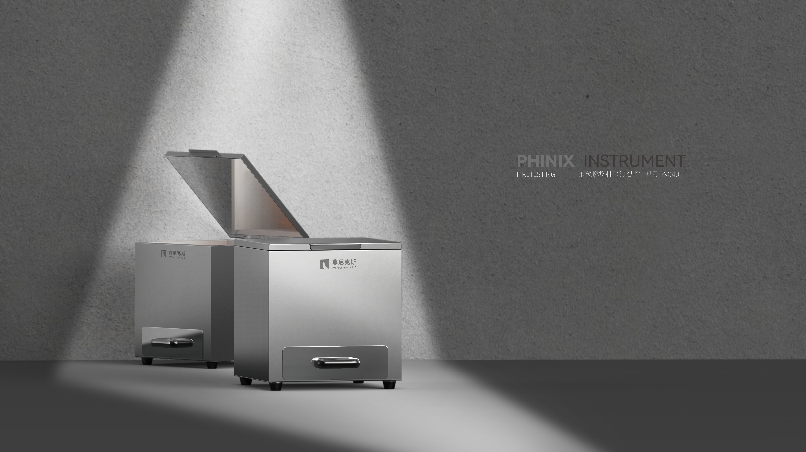
The Expert In Fire Testing
Carpet Combustion Tester
Carpet flammability tester, used to test the flammability and flame retardant performance of carpet under small flame. You can test it in two ways:
Metal nut method
Heat stainless steel nuts to 900 ° C in muffle oven. When the test sample is put into the test box, the clamp ring is placed on the sample with crucible tongs, and the heated nut is placed on the clamp
Ring center, remove the nut after 30 seconds, then measurements can be made to evaluate the spread of the ignition point on the sample.
Urotropine pill Method (prepared by customer) :
After the test sample is put into the test box, the clamping ring is placed on the sample, and the standard pill is lit. After the flame is extinguished, measurement can be carried out to evaluate the combustion effect.
Product Standard
Product Parameter
ISO 6925: Flame performance of carpets - Test method for tablets at room temperature
CFR1630/1631: Flame retardant requirements for blankets
BS6307: Determination of the effect of a Small Fire on floor coverings (Methylamine tablet Test)
BS4790: determination of the effect of small ignition sources on floor coverings (hot metal)
Nut method)
GB/T 11049: Flammability of carpets -- Test method for tablets at room temperature
Model PX04011
Dimension 300(W)×300(D)×300(H)mm
Power Supply None
Weight APPR. 10kg
Consumables Urotropine pills
Feature
Stainless steel chamber, internal size of 300*300*300mm
The interior of the chamber body is covered with high temperature resistant material to prevent damage to the chamber body from flame
The bottom of the box is designed as a drawer structure to facilitate the installation of samples and cleaning after the test
The top door cover can be adjusted by hovering at any Angle, and an observation mirror is installed to observe the sample state
Equipped with 230*230*6.5mm stainless steel platen, middle hole 205mm
Jiangsu Firemana Safety Technology Co., LTD
www.firemana.com
Add: D3 Safe Valley Of China, Tongshan District, Xuzhou City, Jiangsu Province,China
0516-83843888
400-086-0699

