Slide 1
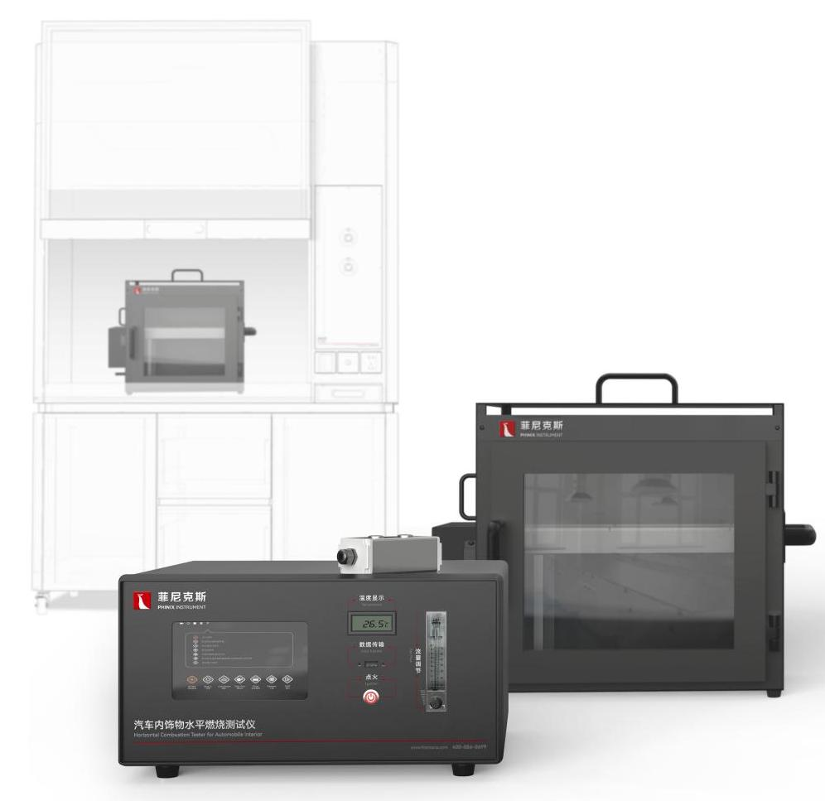
The Expert In Fire Testing
Horizontal Combustion Tester For Automotive Interior（Integrated Type）
The Horizontal Combustion Tester For Automobile Interior is manufactured according to the Federal Motor Vehicle Safety Standard No. 302. The equivalent standard in Europe, Canada and Japan is ISO3795. FMVSS302 specifies the flame retardant testing requirements for materials used in passenger compartments of motor vehicles, such as passenger cars, multi-purpose buses, trucks and buses. The aim is to reduce casualties in the event of a vehicle fire, especially from internal sources such as matches and cigarette butts.
Product Standard
FMVSS 302 Federal Automotive Safety Standard 302
ISO 3795
GB/T 8410-2006
Ms300-08 Modern automobile safety standard
Product Parameters
Model PX06003
Combustion Cabinet 385(L)×204(D)×360(H)mm
Draught Cupboard 1500(L)×850(D)×2350(H)mm
Power Supply AC 220V , 50/60Hz, 5A
Weight APPR. 210kg
Gas Source Liquefied petroleum gas
Dimension
Features
Steel structure chamber, combustion chamber three-door structure, the top cover can be opened to facilitate the cleaning of the box after the test
The front panel is installed with high temperature toughened glass observation window, which is easy to observe the test state and can be opened to facilitate the cleaning of the glass
A temperature controller is installed in the middle of the rear of the chamber body. The temperature of the chamber body is monitored in real time by the instrument. The measuring range is 0-200℃
Stainless steel sample holder with heat-resistant wire (for flexible fabric testing) and splint, with 38mm,138mm,254mm marking line on the splint for easy observation
Equipped with imported precise rotor flowmeter to control gas and air flow
Steel structure ventilation cabinet, sliding door cabinet door operation is simple and labor-saving, large operation space
The control box surface plate is integrated on the fume hood, easy to operate
Jiangsu Firemana Safety Technology Co., LTD
www.firemana.com
Add: D3 Safe Valley Of China, Tongshan District, Xuzhou City, Jiangsu Province,China
0516-83843888
400-086-0699

Slide 2
The Expert In Fire Testing
Continued Page
The door hinge on the left side is fixed, and the sealing of the door is determined by magnetic touch
Pure copper burner, can provide the standard requirements of 38mm stable fire source
The burner is installed on the side door and positioned at the firing position when closing the door. The flame locator is installed on the side door to confirm the flame height
High pressure pulse automatic ignition, ignition stability and reliability, high security
Equipped with PP fan, optional butterfly valve, can control the gas flow rate of 0.1~0.5M/S to meet the standard test wind speed
Programmable logic controller (PLC)+ touch screen control, can realize automatic control/detection/calculation/data storage
Equipped with hand-held button box for timing operation,PLC automatic timing, timing accuracy of 0.1s
Linear combustion rate (V) calculated by PLC, data displayed and saved by touch screen
Jiangsu Firemana Safety Technology Co., LTD
www.firemana.com
Add: D3 Safe Valley Of China, Tongshan District, Xuzhou City, Jiangsu Province,China
0516-83843888
400-086-0699

