Slide 1
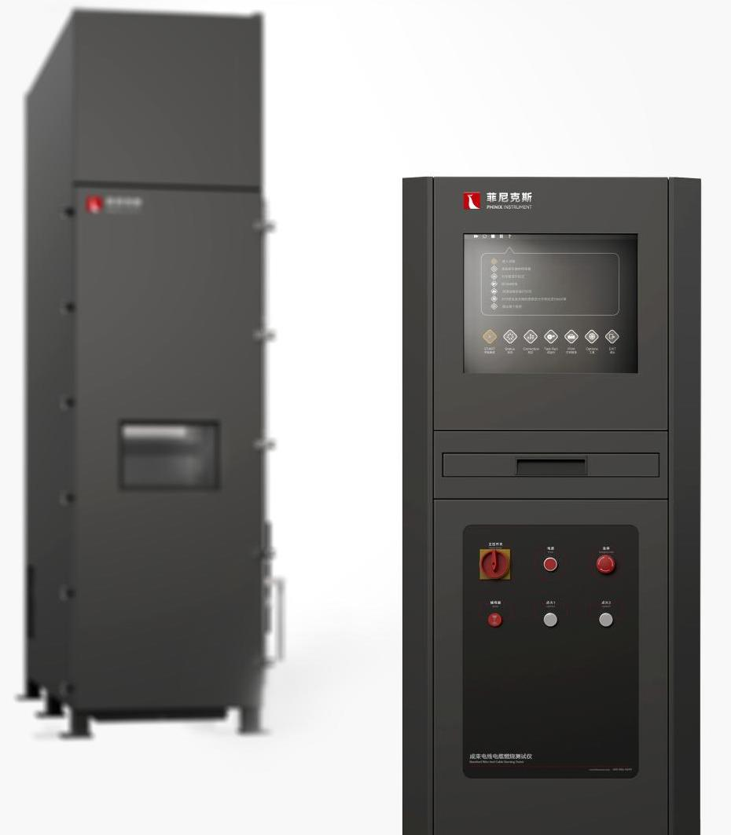
The Expert In Fire Testing
Bunched Wire And Cable Burning Test Apparatus
Bunched Wire And Cable Burning Test Apparatus is a kind of test equipment used to evaluate the ability of vertically installed bunching wire and cable or optical cable to suppress the vertical spread of flame under specified conditions
Product Standard
IEC 60332-3-10: Vertical flame spread test for vertically mounted bundles of wire or cable
EN 50399: Electrical wires and cables subjected to fire classification tests
GB/T 18380.3: Fire test of cables under flame condition
Product Parameters
Model PX02003
Combustion Chamber:1000(W)×2000(D)×4000(H)mm
Control Chamber:650(W)×650(D)×1600(H)mm
Power Supply AC 220V,10A，AC380V,15A 50Hz
Weight APPR. 1500kg
Gas Source Propane, compressed air
Dimension
Features
Steel structure combustion chamber, inner wall is stainless steel plate, filled with mineral wool insulation
The front end of the combustion chamber is equipped with an open and sealed steel door with fire-resistant toughened glass observation window
Independent electric control cabinet, convenient site layout arrangement
Belt propane blowtorch with imported Venturi mixer (optional wide ladder and double blowtorch)
Equipped with high-precision MFC to control gas and air feed, and through venturi mixing, the burner can provide a stable fire source
Equipped with 3 type K thermocouples for flame temperature testing
In the air supply section, adjustable speed blower and frequency converter are used to control the air inlet velocity, and the air inlet volume is measured by pitot tube and differential pressure sensor.
The upper part of the test chamber is equipped with pitot tube and differential pressure sensor for wind speed measurement to ensure the test wind speed.
Equipped with standard steel ladder width 500±5mm (standard), wide steel ladder width 800±10mm (optional)
Jiangsu Firemana Safety Technology Co., LTD
www.firemana.com
Add: D3 Safe Valley Of China, Tongshan District, Xuzhou City, Jiangsu Province,China
0516-83843888
400-086-0699

Slide 2
The Expert In Fire Testing
Continued Page
Equipped with silicon nitride ignition device, ignition stable and reliable
Flameout automatic degase protection device, programmable controller (PLC)+ MFC to achieve automatic control of ignition and flameout propane and air supply sequence
Equipped with stainless steel movable trolley, used for placing and adjusting the test position of blowtorch, easy to use
The lifting mechanism is used for sample installation and removal, and the total lifting weight is more than 1T
Computer + professional software control, guided operation, easy to operate safe and reliable
Can automatically adjust the test conditions, display the various states in the test, to record the test results
Jiangsu Firemana Safety Technology Co., LTD
www.firemana.com
Add: D3 Safe Valley Of China, Tongshan District, Xuzhou City, Jiangsu Province,China
0516-83843888
400-086-0699

