Slide 1
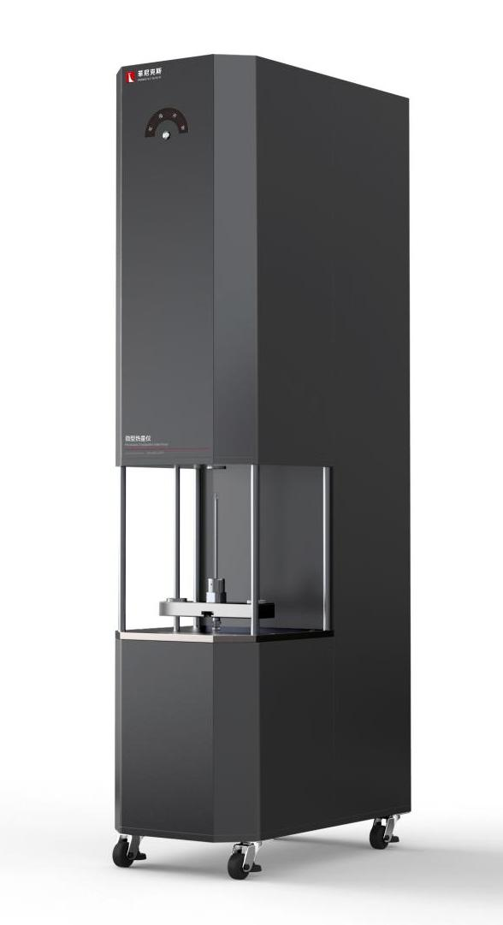
The Expert In Fire Testing
Micro Calorimeter
The micro calorimeter can determine basic chemical thermal values and predict the fire resistance of materials in a matter of minutes. This technique can quickly determine parameters such as specific heat release rate (W/g), combustion heat (J/g), and ignition temperature (°C) on very small samples (1-10mg) with low cost, high accuracy, and typical repeatability of ±5%. Microcalorimeter data is associated with cone calorimeter, LOI oxygen index meter, UL94 horizontal/vertical combustion meter, oxygen bomb calorimeter, etc., and is therefore regarded as an efficient, low-cost tool for determining and predicting the fire resistance of materials.
Product Standard
ASTM D7309-2007: Standard Test Method for Determining the Flammability of Plastics and Other Solid Materials by Microcombustion Calorimeter
EMC 89/336/EEC: Electromagnetic compatibility 89/336/EEC
LVD 72/23/EEC
BS EN 60204-1: Safety of machinery - Electrical equipment for machinery - Part 1: General requirements
BS EN 746-2: Industrial thermal processing equipment. Safety requirements for combustion and fuel handling systems
Product Parameters
Model PX01008
Dimension 343(W)×663(D)×1560(H)mm
Power Supply AC220V,16A
Weight APPR. 80kg
Gas Source Purity above 99.99% oxygen and nitrogen, compressed air
Features
Integrated structure design, beautiful and generous
Combustion furnace: programmed control the temperature of combustion furnace heating to the specified temperature, constant temperature, temperature drift does not exceed 5K/h. Equipped with overtemperature protection device to protect the safety of equipment and personnel during the test
Temperature range: room temperature -1000℃, imported electric heating wire, over temperature protection, high-performance heating elements, longer service life
High precision MFC (mass flow controller), control air, oxygen, nitrogen gas intake, response time less than 1S, accuracy F.S±1%.
Imported oxygen sensor, range: 0-100%, T90<6 s. Accuracy ±0.1%, linear range: F.S±1%
The equipment is fast in testing and convenient in testing
LABVIEW data acquisition software, configuration computer control
Jiangsu Firemana Safety Technology Co., LTD
www.firemana.com
Add: D3 Safe Valley Of China, Tongshan District, Xuzhou City, Jiangsu Province,China
0516-83843888
400-086-0699

Slide 2
The Expert In Fire Testing
Continued Page
Multiple heat dissipation device, the instrument heat dissipation fast
Sample heating rate can be adjusted
The sample cup is equipped with a temperature sensor
The sample cup can be automatically moved to the combustion furnace, special design to ensure soft contact
The equipment provides anaerobic and aerobic environmental high temperature decomposition test mode.
Displays the running status of devices in real time
Calibrate equipment and store calibration data results
Collect data during the test.
Heat release rate coefficient (W/g), combustion heat (J/g), ignition temperature (°C) and other parameters were calculated.
Jiangsu Firemana Safety Technology Co., LTD
www.firemana.com
Add: D3 Safe Valley Of China, Tongshan District, Xuzhou City, Jiangsu Province,China
0516-83843888
400-086-0699

