Slide 1
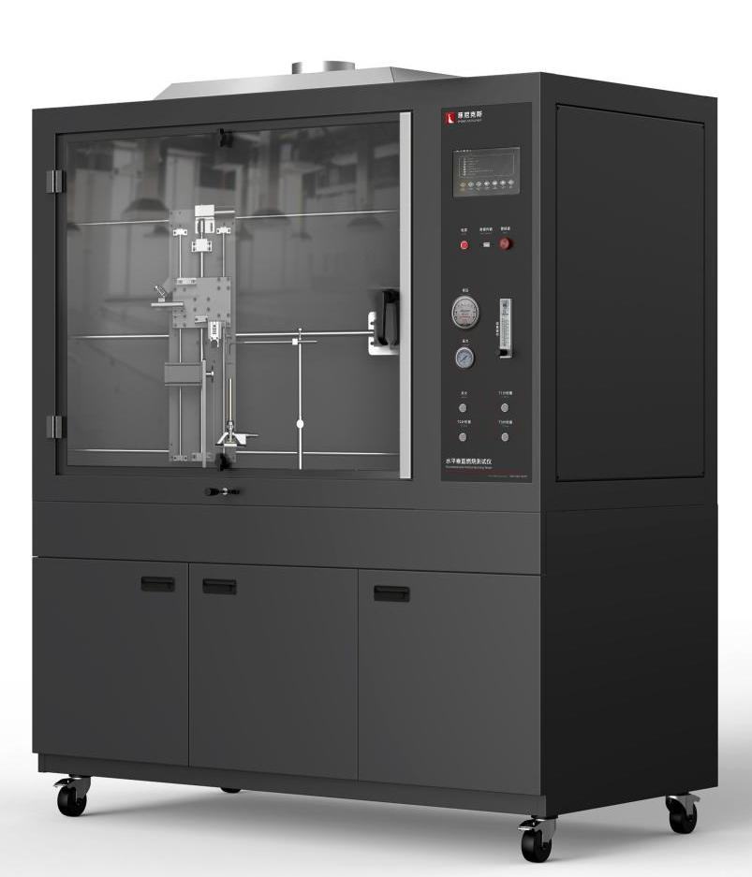
The Expert In Fire Testing
Automatic Horizontal And Vertical Burning Tester
Automatic Horizontal and vertical combustion tester is the flame retardant testing equipment developed by our company according to the standard. It can detect the flammability, combustion rate, flame spread, combustion intensity and flame retardant performance of the product. High degree of automation, accurate test data.
Product Standard
Horizontal combustion test: UL94 HB, IEC 60695-11-10, IEC 60707, ISO 1210, GB/T 2408;
50W vertical combustion test: UL94 V0, V1, V2, IEC 60695-11-10, ISO 1210, GB/T 2408;
500W vertical combustion test: UL94 5VA, 5VB, IEC 60695-11-20, ISO 9770, GB/T 5169.17;
Thin film material vertical combustion test (optional) : VTM-0, VTM-1, VTM-2, ISO 9773;
Product Parameters
Model PX03002
Dimension 1350(W)×700(D)×1000(H)mm
Bottom cabinet 1350(W)×700(D)×650(H)mm
Power Supply AC 220V, 50Hz, 2A
Weight APPR.70kg
Features
Steel structure chamber, test chamber volume more than 0.75 cubic meters, to provide adequate clean air for the test.
Large observation window, inner wall coating is dark, illumination within 20Lux, easy to observe the combustion state of the sample.
Smoke exhaust device is installed on the top, which can automatically open to discharge test exhaust gas after the end of the test.
Introduction of industrial design concept of structure, appearance and interface design, easy to operate, friendly interface, ergonomic and operating habits, beautiful appearance
The sample fixture can achieve smooth movement and precise positioning in horizontal and vertical directions by sliding rail structure.
High pressure pulse automatic ignition, ignition stability and reliability, high security
Equipped with imported precise rotor flowmeter to control gas flow, equipped with imported differential pressure measurement burner back pressure.
Equipped with brand pressure gauge and pressure regulating valve to adjust gas pressure, equipped with solenoid valve to control gas on and off, to ensure the safety of equipment.
Jiangsu Firemana Safety Technology Co., LTD
www.firemana.com
Add: D3 Safe Valley Of China, Tongshan District, Xuzhou City, Jiangsu Province,China
0516-83843888
400-086-0699

Slide 2
The Expert In Fire Testing
Continued Page
Equipped with HUMBOLDT Tirell fire source, inner diameter 9.5±0.3mm, in accordance with ASTM D5025 standard, can produce standard requirements of 50W&500W flame
Burner Angle can be 0, 20, 45 degrees convenient adjustment, to meet the requirements of different test methods. Through the sliding device, the positioning device can be quickly delivered to the predetermined fire location
Equipped with stainless steel horizontal and vertical sample fixture, durable
Programmable logic controller (PLC)+ touch screen control, can realize automatic control/detection/calculation/data storage
Test time, fire time can be set by oneself, software automatic timing
Linear combustion rate (V) PLC calculation, touch screen display and save
Different test methods can be switched on the touch screen, and test standard reference values can be displayed on the touch screen
It has the function of reminding the arrival of flame impact time and automatically cutting off the air source without experiment for 10 minutes to ensure the safety of use
Optional 50W, 500W flame calibration kit, imported brand thermocouple measurement accuracy ±0.1℃, can automatically generate calibration curve and determine
Jiangsu Firemana Safety Technology Co., LTD
www.firemana.com
Add: D3 Safe Valley Of China, Tongshan District, Xuzhou City, Jiangsu Province,China
0516-83843888
400-086-0699

