Slide 1
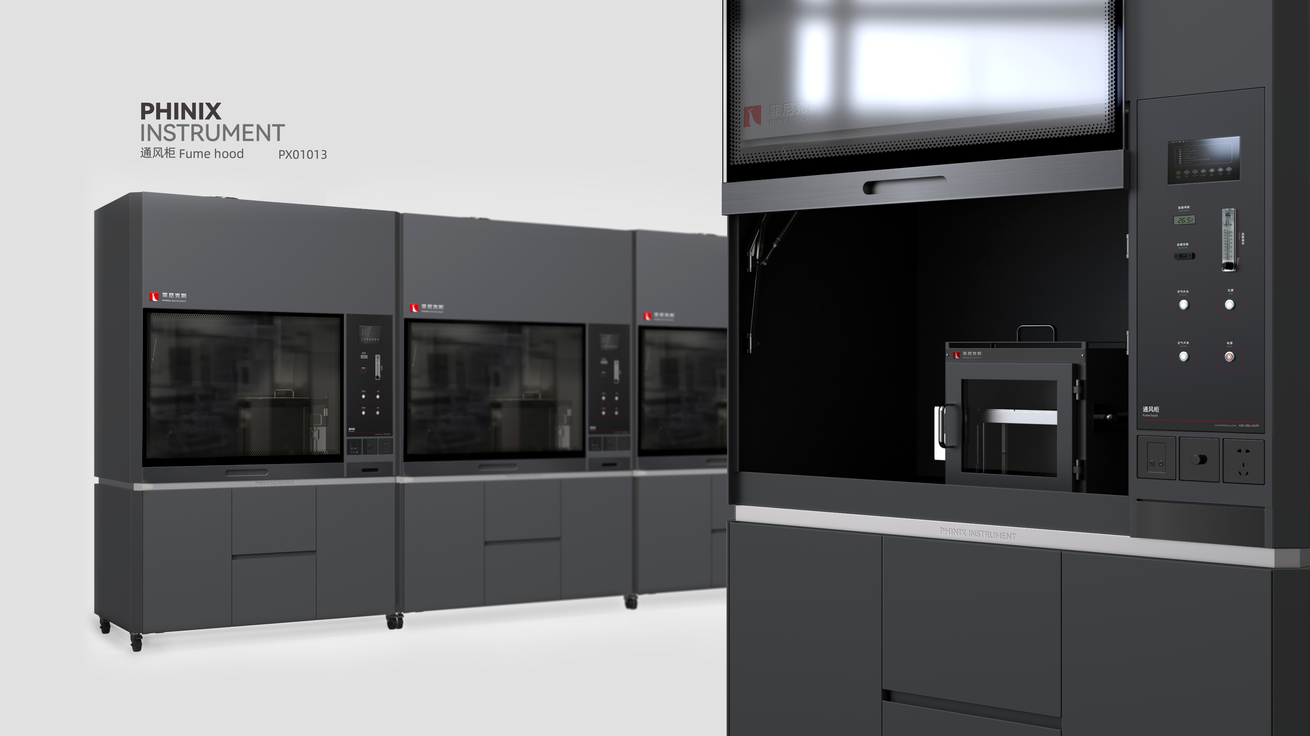
The Expert In Fire Testing
Fume Hood
Fume hood in order to make the laboratory staff do not inhale or swallow into some toxic, pathogenic or unknown toxic chemicals and organisms, to ensure that there should be good ventilation in the laboratory, prevent some steam, gas and particles (smoke, soot, dust and air suspension) absorption of laboratory equipment.
Product Parameters
Feature
Model PX01013
Dimension 1500(W)×850(D)×2350(H)mm
Power Supply AC 220V, 15A
Weight APPR. 180kg
Gas Source None
Import industrial design concept of appearance design, beautiful and generous, easy to operate
Stainless steel fume hood, equipped with cabinets, drawers and other functions convenient storage, surface spray treatment, strong adhesion, surface hardness, corrosion resistance
Sliding door toughened glass cabinet door is easy to operate and labor-saving, large operating space
Operating table for physical and chemical board, high hardness, strong corrosion resistance, easy to clean
Jiangsu Firemana Safety Technology Co., LTD
www.firemana.com
Add: D3 Safe Valley Of China, Tongshan District, Xuzhou City, Jiangsu Province,China
0516-83843888
400-086-0699

Slide 2
The Expert In Fire Testing
Continued Page
Fluorescent lamp: the fluorescent lamp is hidden on the panel, does not contact with the airflow in the fume hood, easy to replace. The use of 30W fluorescent lamp 1, and with 5mm toughened glass
Equipped with power interface
All-steel integrated smoke hood, high resistance, corrosion resistance, stable structure
Equipped with smoke exhaust fan
Equipped with air valve
Jiangsu Firemana Safety Technology Co., LTD
www.firemana.com
Add: D3 Safe Valley Of China, Tongshan District, Xuzhou City, Jiangsu Province,China
0516-83843888
400-086-0699

