Slide 1
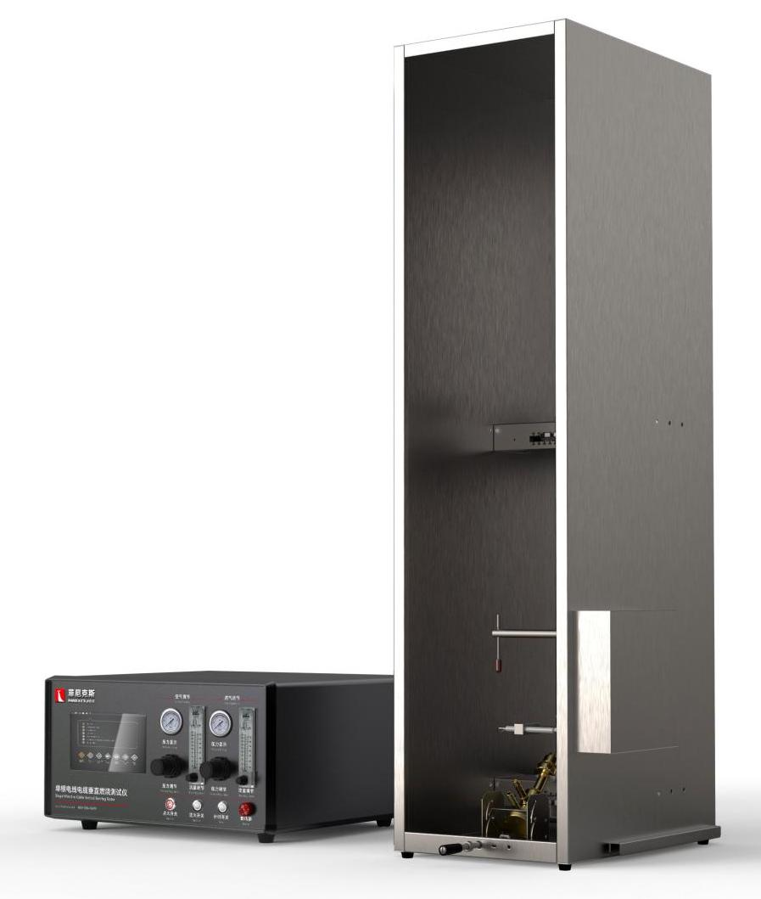
The Expert In Fire Testing
Single Wire And Cable Vertical Burning Test Apparatus
Single wire and cable combustion tester, used for single wire and cable or cable vertical flame spread test, at the same time can test the burning condition of dripping objects under the condition of 1Kw flame
Product Standard
IEC 60332-1-1, 2, 3: Tests on cables and optical cables under fire conditions
GB/T 18380.11, 12: Cable and optical cable fire test under flame condition
GB/T 5169.14:1KW nominal premixed flame
Product Parameters
Model PX02002
Equipment 300(W)×450(D)×1200(H)mm
Control Cabinet 500(W)×400(D)×250(H)mm
Power Sup. AC 220V,2 A
Weight APPR. 80kg
Gas Source Propane purity above 95%,Dry compressed air
Dimension
Features
All stainless steel Chamber body, internal cavity height 1200mm, width 300mm, depth 450mm
Separate control cabinet and combustion cabinet, reduce the impact of combustion heat on electrical parts, improve the service life of equipment
The premixed blowtorch made of pure copper meets the standard requirements and can provide 1Kw fire source
The burners can be adjusted vertically and 45 degrees to meet the requirements of test ignition and fire source correction.
Equipped with imported precise rotor flowmeter to control gas and air flow
Equipped with brand pressure gauge and pressure regulating valve to adjust gas and air pressure, equipped with solenoid valve to control gas on and off, to ensure the safety of equipment.
Programmable logic controller (PLC)+ touch screen control, can realize automatic control/detection/calculation/data storage
Experimental time, fire time can be set by oneself, software automatic timing
Jiangsu Firemana Safety Technology Co., LTD
www.firemana.com
Add: D3 Safe Valley Of China, Tongshan District, Xuzhou City, Jiangsu Province,China
0516-83843888
400-086-0699

Slide 2
The Expert In Fire Testing
Continued Page
Through the sliding rail module, the positioning mechanism to achieve fast and accurate fire position.
High pressure pulse automatic ignition, ignition stability and reliability, high security
The clamp with vortex spring structure can easily clamp samples of different wire diameters
Specific flame impact time to remind function and 10 minutes no experiment automatically cut off the air source function, to ensure the use of safety.
Optional 1Kw flame calibration package, imported brand thermocouple measurement accuracy ±0.1℃, can automatically generate calibration curve and determine.
Jiangsu Firemana Safety Technology Co., LTD
www.firemana.com
Add: D3 Safe Valley Of China, Tongshan District, Xuzhou City, Jiangsu Province,China
0516-83843888
400-086-0699

