Slide 1
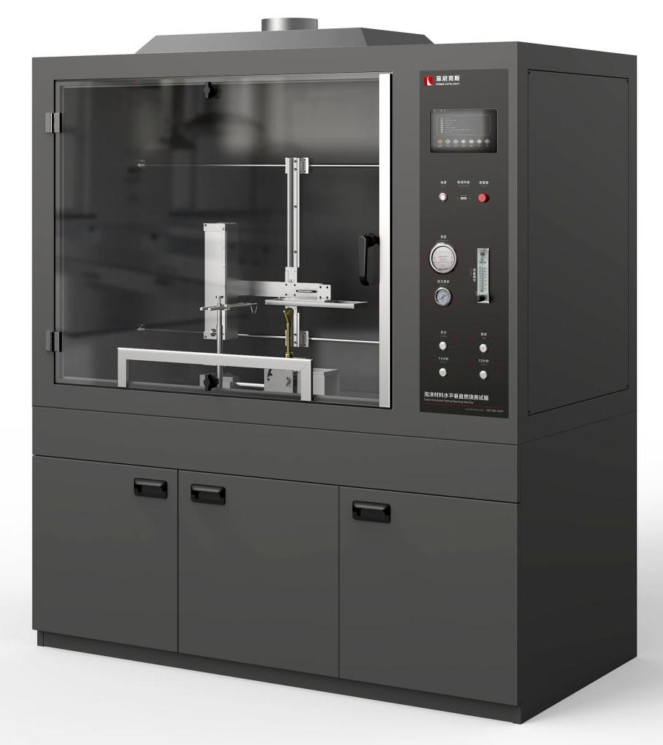
The Expert In Fire Testing
Foam Horizontal Vertical Burning Test Apparatus
The horizontal and vertical combustion test chamber for foam products is designed to test the flammability of foam materials for equipment and appliances. A wide range of end-use test indicators such as flammability, combustion rate, flame spread, combustion strength and flame retardant properties of the product can be detected. High degree of automation, accurate test data.
Product Standard
ISO 9772: Determination of horizontal combustion properties of styrofoam plastics
GB/T 8332: Test method for flammability of foam plastics -- Horizontal combustion method
GB/T 8333: Rigid foam plastics -- Test method for fire performance -- Vertical combustion method
Product Parameters
Model PX01010
Dimension 1350(W)×700(D)×1000(H)mm
Bottom cabinet 1350(W)×700(D)×650(H)mm(optional)
Power Supply AC 220V, 50/60Hz, 2A
Weight APPR. 70kg
Gas Source Methane purity above 95%
Features
Steel structure chamber, test chamber volume more than 0.75 cubic meters, to provide adequate clean air for the test.
Large observation window, the inner wall of the chamber is coated with black, and the illumination is within 20Lux, which is convenient to observe the combustion condition of the sample.
Smoke exhaust device is installed on the top, which can automatically open to discharge test exhaust gas after the end of the test.
Introduction of industrial design concept of structure, appearance and interface design, integrated panel structure, easy to operate, friendly interface, ergonomic and operating habits, beautiful appearance
The level test fixture is stainless steel metal mesh plate, equipped with standard requirements of metal screen for foam level test. Vertical test fixture is stainless steel chimney with fixed pin support, equipped with ruler to measure flame height, heat resistant tempered glass installed in front for easy inspection
Horizontal test and vertical test fixture can achieve horizontal and vertical smooth movement and precise positioning through the slide rail structure. Different test, fixture can be freely switched without re - installation.
Equipped with imported precise rotor flowmeter to control gas flow, equipped with imported differential pressure measurement burner back pressure.
Jiangsu Firemana Safety Technology Co., LTD
www.firemana.com
Add: D3 Safe Valley Of China, Tongshan District, Xuzhou City, Jiangsu Province,China
0516-83843888
400-086-0699

Slide 2
The Expert In Fire Testing
Continued Page
Equipped with American HUMBOLDT Tirell fire source, tube diameter 9.5±0.3mm, in line with ASTM D5025 standard, and equipped with standard requirements of fishtail lamp for horizontal test
The burner Angle can be adjusted 15 degrees and 90 degrees to meet the requirements of different test methods. Through the motor transmission device, the burner can be quickly sent to the predetermined test fire position
High pressure pulse automatic ignition, ignition stability and reliability, high security
Equipped with brand pressure gauge and pressure regulating valve to adjust gas pressure, equipped with solenoid valve to control gas on and off, to ensure the safety of equipment.
Programmable logic controller (PLC)+ touch screen control, can realize automatic control/detection/calculation/data storage
Test time, fire time can be set by oneself, software automatic timing
Linear combustion rate (V) calculated by PLC, data displayed and saved by touch screen
Different test methods can be switched on the touch screen, and test standard reference values can be displayed on the touch screen
Jiangsu Firemana Safety Technology Co., LTD
www.firemana.com
Add: D3 Safe Valley Of China, Tongshan District, Xuzhou City, Jiangsu Province,China
0516-83843888
400-086-0699

