Slide 1
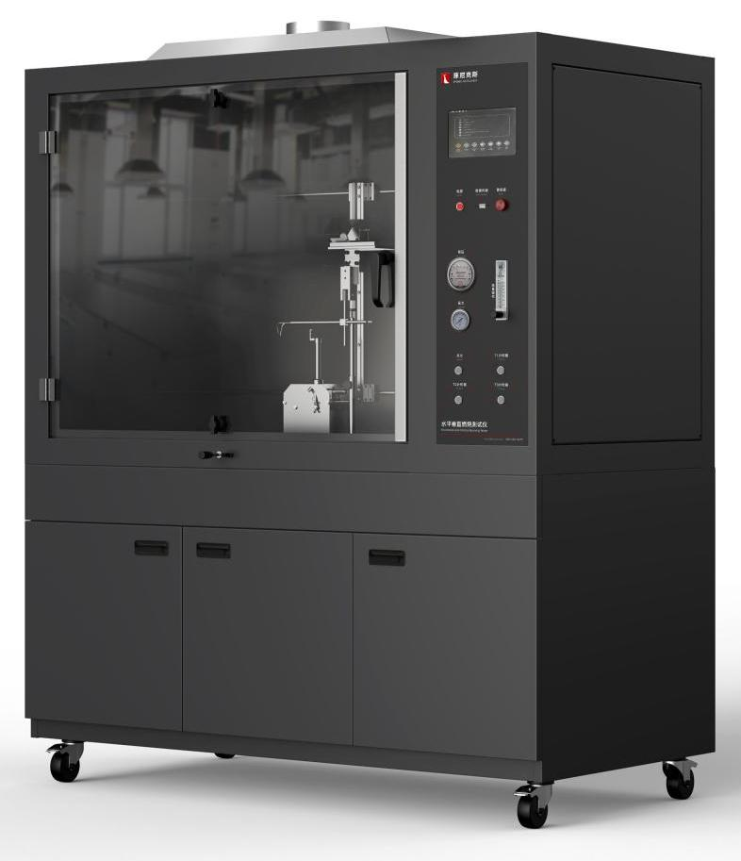
The Expert In Fire Testing
Needle Flame Combustion Tester
Needle flame combustion tester, designed for under specified conditions the experimental flame will not ignite parts, or the experimental flame ignites combustible parts, but the combustion duration or combustion length of parts is limited, and the flame or burning or hot particles falling from the test sample will not be the test equipment for combustion spread. High degree of automation, accurate test data.
Product Standard
GB/T 5169.5 Experimental flame needle flame test method apparatus, validation test method and guidelines
Iec60695-11-5 Needle flame test method. Protocols and guidelines for installation and verification tests
Product Parameters
Model PX03004
Equipment：1350(W)×700(D)×1000(H)mm
Bottom cabinet：1350(W)×700(D)×650(H)mm
Power Sup. AC 220V, 50/60Hz, 2A
Weight APPR. 70kg
Gas Source Industrial methane with purity above 98%
Dimension
Features
Steel structure chamber, test chamber volume more than 0.75 cubic meters, to provide adequate clean air for the test.
Large observation window, the inner wall of the box is coated with dark color, and the illumination is within 20Lux, which is convenient to observe the combustion condition of the sample.
Smoke exhaust device is installed on the top, which can automatically open to discharge test exhaust gas after the end of the test.
Introduction of industrial design concept of structure, appearance and interface design, integrated panel structure, easy to operate, friendly interface, ergonomic and operating habits, beautiful appearance
High pressure pulse automatic ignition, ignition stability and reliability, high security
Equipped with stainless steel fixture, durable; The sample fixture can achieve smooth movement and precise positioning in horizontal and vertical directions by sliding rail structure.
Equipped with imported precise rotor flowmeter to control gas flow, equipped with imported differential pressure measurement burner back pressure.
Equipped with brand pressure gauge and pressure regulating valve to adjust gas pressure, equipped with solenoid valve to control gas on and off, to ensure the safety of equipment.
Programmable logic controller (PLC)+ touch screen control, can realize automatic control/detection/calculation/data storage
Jiangsu Firemana Safety Technology Co., LTD
www.firemana.com
Add: D3 Safe Valley Of China, Tongshan District, Xuzhou City, Jiangsu Province,China
0516-83843888
400-086-0699

Slide 2
The Expert In Fire Testing
Continued Page
The burner made of brass has good thermal stability and low deformation at high temperature. The diameter of the fire nozzle is 0.5±0.1mm, the outer diameter is 0.9mm, and the length is 35mm. It meets the standard requirements and has a protective device to prevent accidental damage.
The Angle of the burner can be easily adjusted to 0 or 45 degrees to meet the position requirements of the sample subjected to fire and temperature correction
Test time, fire time can be set by oneself, software automatic timing
Linear combustion rate (V) calculated by PLC, data displayed and saved by touch screen
It has the function of reminding the arrival of flame impact time and automatically cutting off the air source without experiment for 10 minutes to ensure the safety of use.
Optional temperature calibration package, imported thermocouple measurement accuracy ±0.1℃, can automatically generate calibration curve and determine.
Jiangsu Firemana Safety Technology Co., LTD
www.firemana.com
Add: D3 Safe Valley Of China, Tongshan District, Xuzhou City, Jiangsu Province,China
0516-83843888
400-086-0699

