Slide 1
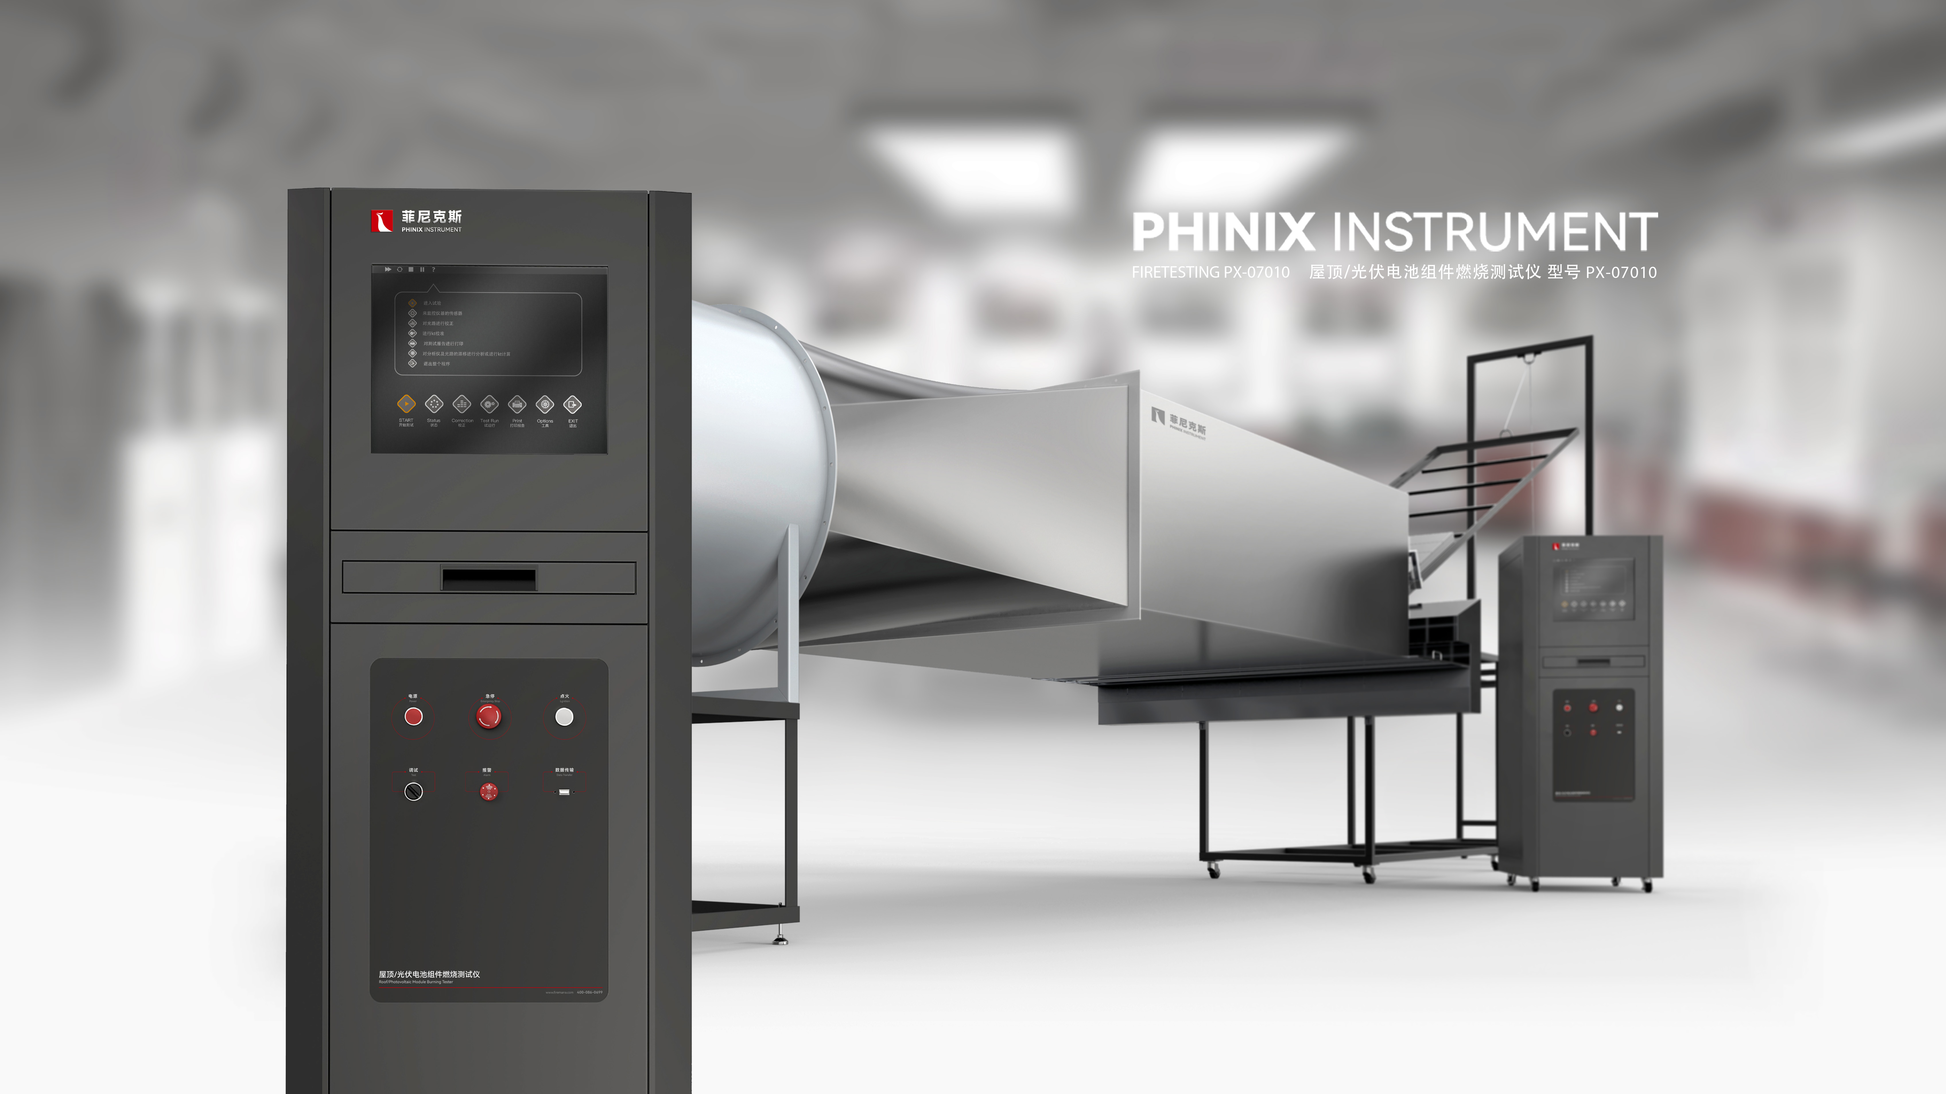
The Expert In Fire Testing
Roof PV Module Combustion Tester
The fire reactivity test device of roof materials is developed according to GB/T 30735-2014 "Roof and Roof covering products External Reaction Test Method to Fire". This test method mainly refers to THE T1 test method in ENV 1187 and ISO 12468-1. This method provides three kinds of test methods under fire conditions. Method A corresponds to T1 in ENV 1187, and methods B and C correspond to ISO 12468-1. Under the regulation of wind and heat radiation, the reaction of roof and roof covering products to fire was tested.
Product Standard
Product Parameter
ISO International Organization for Standardization: ISO 12468-1: B-2013, ISO 12468-1: C-2013
EN European Standard: ENV 1187: T1:2002
GB Chinese standard: GB/T 30735:2014
Model PX07010
Dimension 2100mm(L)×1900mm×(H)×900mm(W)
Power Supply AC220V,50A；380V，15KW
Weight APPR. 400kg
Gas Source Propane
Feature
Combustion and sample device frame structure, stable structure
The control chamber and gas distribution cabinet are designed independently to facilitate laboratory arrangement and ensure the safety of equipment
The radiation surface size of the radiation plate is 600mm×600mm.
Small stainless steel tube burners are available for particle-burning test use
1 set of wood crib fire gas combustion device
The burner is equipped with silicon nitride ignition rod and UV flame detector, ignition is stable and reliable, and has real-time flame monitoring effect, prevent gas leakage, improve test safety
Test sample rack test Angle can be adjusted, using pneumatic adjustment mode, users only need to press the button operation, easy to use
The Angle of the test bracket can be adjusted from 0 to 50 degrees, which meets the test requirements of ISO 12468 method A and ENV 1187 T1 that the maximum tilt height of the sample is 45 degrees
Air duct material for SUS304 stainless steel, thickness of 2mm, upper air duct is equipped with a fine honeycomb grid, the exit of the coarse honeycomb grid
Fan specifications: maximum wind speed of the fan is 250 m3 /min, fan motor power is 5.5KW
Fan frequency conversion adjustment device: 3-phase 380V power 5.5KW
Jiangsu Firemana Safety Technology Co., LTD
www.firemana.com
Add: D3 Safe Valley Of China, Tongshan District, Xuzhou City, Jiangsu Province,China
0516-83843888
400-086-0699

Slide 2
The Expert In Fire Testing
Continued Page
Choose imported high-precision rotor flowmeter to control the gas flow, equipped with brand pressure gauge to control the gas flow, equipped with solenoid valve, automatically cut off the gas at the end of the test, to ensure safety
The test sample frame structure is made of metal square tube welding and Angle steel
Air duct adopts ball screw, servo motor drive mode, can automatically adjust the Angle
The adjustable air duct Angle ranges from 0 to 35 degrees, meeting methods B and C in ISO 12468
Equipped with three impeller anemometers, accuracy of 0.1m/s
Computer + professional software control and guide the test process, easy to operate, safe and reliable
Jiangsu Firemana Safety Technology Co., LTD
www.firemana.com
Add: D3 Safe Valley Of China, Tongshan District, Xuzhou City, Jiangsu Province,China
0516-83843888
400-086-0699

