Slide 1
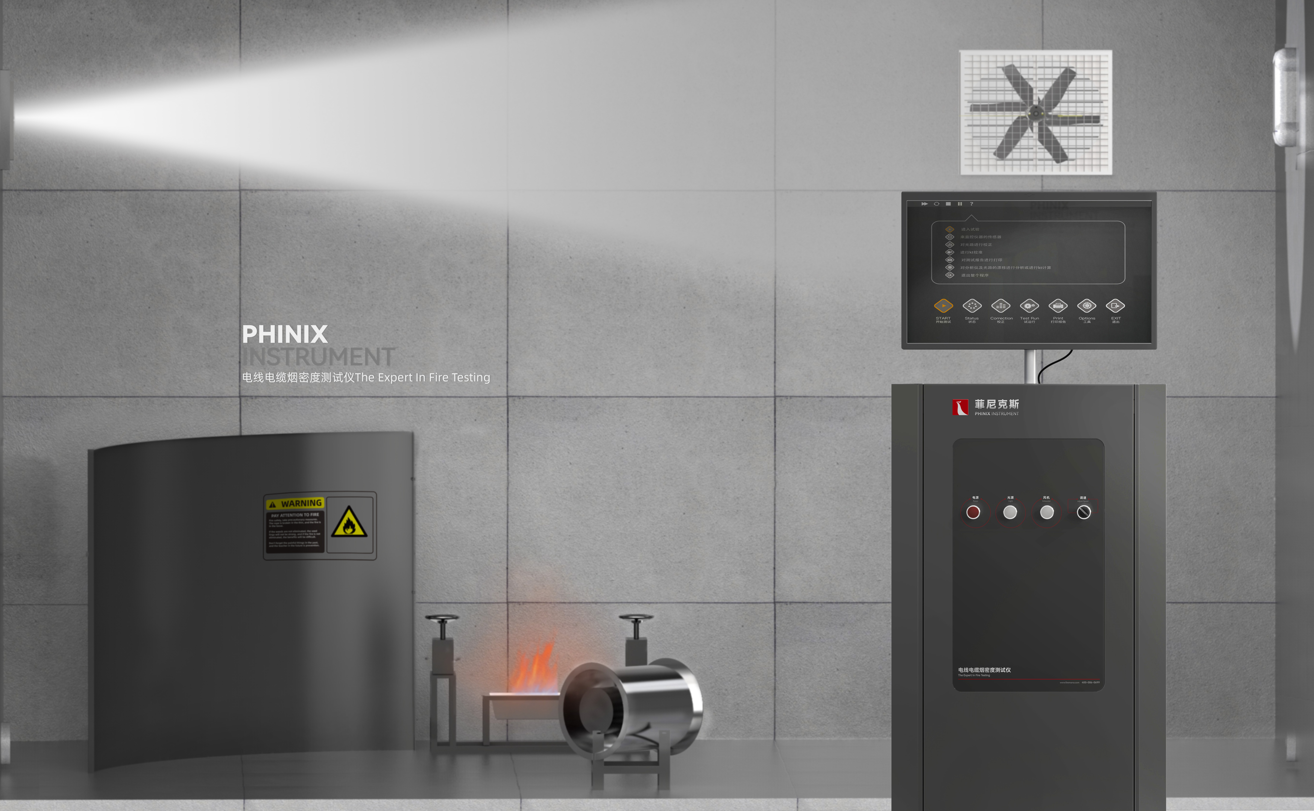
The Expert In Fire Testing
Wire And Cable Smoke Density Tester
Wire and cable smoke density tester is used to test the cable or optical cable in the specified combustion conditions, horizontal placement, and in a clear fire source when burning smoke condition, this equipment in the measurement of cable exposure to the specified standard heat source smoke condition plays an important role.
Product Standard
Product Parameters
• IEC 61034, 1 & 2: Measurement of smoke density from cable combustion under specified conditions
- Part 1: Test equipment
- Part 2: Test process and requirements
• BS 6853: General code for fire prevention in the design and construction of passenger carrying trains
• GB/T 17651.1&2: Determination of smoke density from burning of cables and optical cables under specified conditions
Model PX02007
Combustion Chamber：3000(W)×3000(D)×3000(H)mm
Control Chamber：600(W)×600(D)×1000(H)mm
Power Supply AC 220V,10A
Weight APPR. 100kg
Gas Source Distilled water, methanol, toluene, anhydrous ethanol
Dimension
Features
The combustion chamber consists of a cubic structure of 3000mm±30mm
Smoke collecting hood, smoke exhaust pipe and air valve should be installed in the appropriate position of the combustion chamber, and the smoke in the test chamber should be eliminated after the test
Standard light source: power 100W, 12V, luminous flux 2000-3000lm, color temperature 2800-3200K
The light source is powered by high-precision voltage regulator, and the voltage display precision is up to 0.001V
Equipped with seat type fan, air volume 1-15m3/min to balance the flue gas in the laboratory, potentiometer to adjust the fan speed
Alcohol metal plate: bottom 210*110mm, top: 240*140mm, height: 80mm
Anhydrous ethanol combustion provides fire source for the sample
Stainless steel clip can quickly clip samples of different wire diameters
Jiangsu Firemana Safety Technology Co., LTD
www.firemana.com
Add: D3 Safe Valley Of China, Tongshan District, Xuzhou City, Jiangsu Province,China
0516-83843888
400-086-0699

Slide 2
The Expert In Fire Testing
Continued Page
The light source system can be precisely focused to the nominal cone diameter of 1.5±0.1M
Imported optical receiving system; Data stability, accuracy, linear error rate &lt; 1%
Equipped with automatic control of the filter correction mechanism, automatic correction of light path, improve the accuracy of testing
Equipped with precision temperature sensor to collect combustion chamber temperature
PC+Labview special software control, display, calculate, store test parameters and test data
Program Set the optical path calibration program to meet the calibration requirements of the test
Jiangsu Firemana Safety Technology Co., LTD
www.firemana.com
Add: D3 Safe Valley Of China, Tongshan District, Xuzhou City, Jiangsu Province,China
0516-83843888
400-086-0699

